Slide 1
Using osmnx with OpenStreetMap to create a shortest path API
A guide by Douglas Bett

Slide 2
About
This guide and example shows how we can leverage the python package osmnx to create a web service that can return the shortest N routes between two points.
We’ll see the various ways of downloading street network data, the various street types we can filter and how to hook the service to an API.

Slide 3
What is osmnx
A python package that lets you easily download geospatial data from OpenStreetMap and model, project, visualize, and analyze real-world street networks and any other geospatial geometries.
Download and model street networks
Download other spatial datasets in form of GeoDataFrame
Easily conduct street network analysis with minimal lines of code.
Simplify and correct network topology.
Handles geocoding for us using OSM Nominatim API.
Automatically processes network topology from raw OpenStreetMap data such that nodes represent intersections/dead-ends and edges represent the street segments that link them.

Slide 4
Problem - How to Find the Shortest Route
Graph networks are one of the best ways to find the shortest routes.
Implementing this using OSM data needs knowledge of how graph networks work, creating them, populating them, fixing topology problems and many more.
Osmnx solves this problem by preparing the data from OSM for some Area Of Interest, creates a network graph for us and provides high level functions we can use to query graphs and the data associated with it.

Slide 5
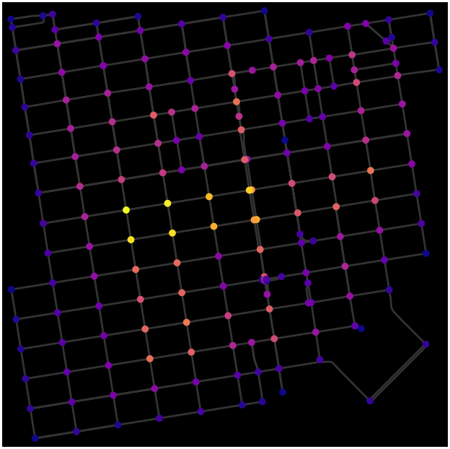
Graph Example
A graph consists of nodes(points connecting two edges) and edges(path connected by two nodes)
Image source: https://networkx.org/documentation/stable//auto_examples/geospatial/plot_osmnx.html
Osmnx uses the networkx package to handle road network graphs.

Slide 6
Getting network graphs from OSM
Search by place name.
Graph from coordinate (lat,lng) plus distance.
Graph from polygon.
Graph from some bounding box

Slide 7
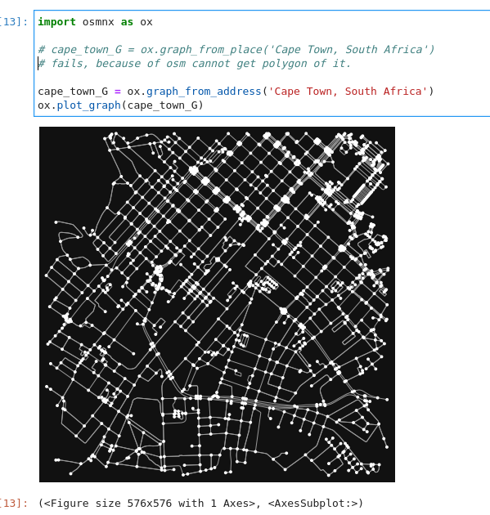
Graph from place
Takes an query as string. The query is used to geocode and use as the central point around which to construct the graph.
The query must be geocodable and OSM must have polygon boundaries for the geocode result. If OSM does not have a polygon for this place, you can instead get its street network using the graph_from_address function, which geocodes the place name to a point and gets the network within some distance of that point.

Slide 8
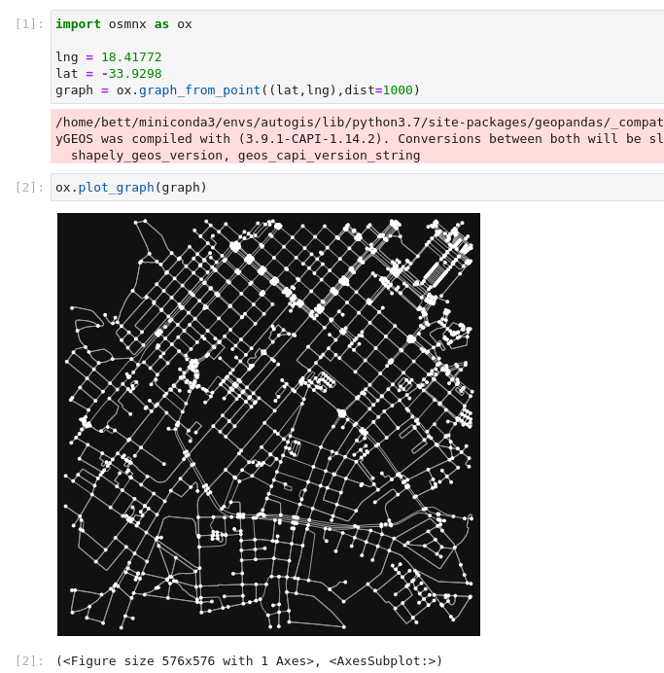
Graph from coordinate plus distance
Takes a tuple of (lat,lng) as center point and distance which filters for nodes within this distance.

Slide 9
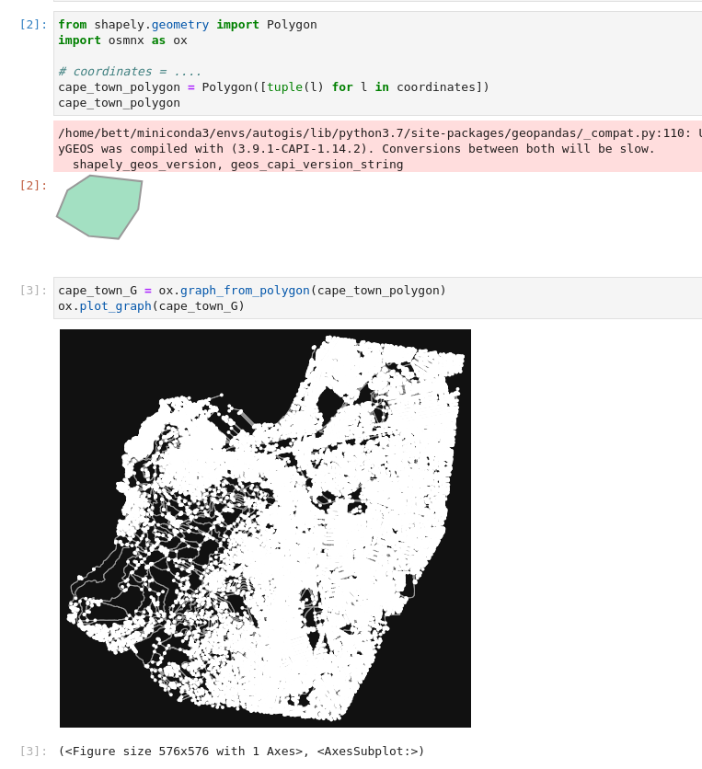
Graph from polygon
Takes a shapely Polygon and returns the graph containing nodes within the polygon.

Slide 10
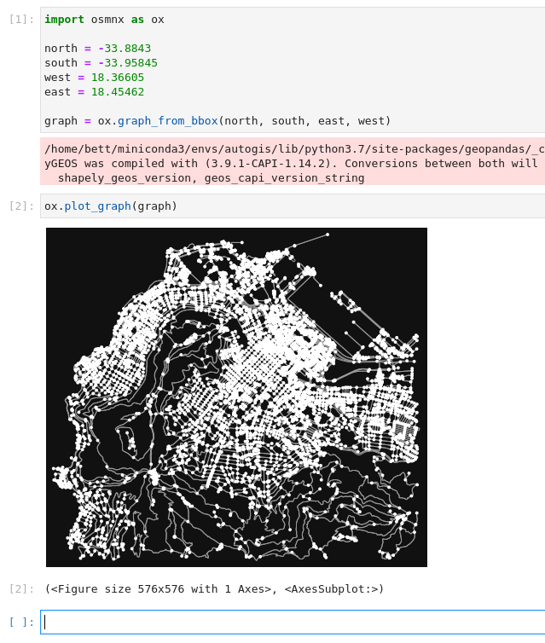
Graph from a bounding box
Create a graph from OSM within some bounding box.

Slide 11
How to get the shortest path(s).
Having downloaded our graph, we can now calculate the shortest paths.
Given two coordinates (coord1, coord2), to find the shortest path between the two coordinates, we need to
Find the nearest node to each of the coordinates.
Query the graph using ox.shortest_path function or ox.k_shortest_paths function
The first returns a series of nodes and the latter returns a list of series of nodes.
Convert the nodes to (x,y) coordinates which now consists of a path/road.

Slide 12
Graph Example

Slide 13
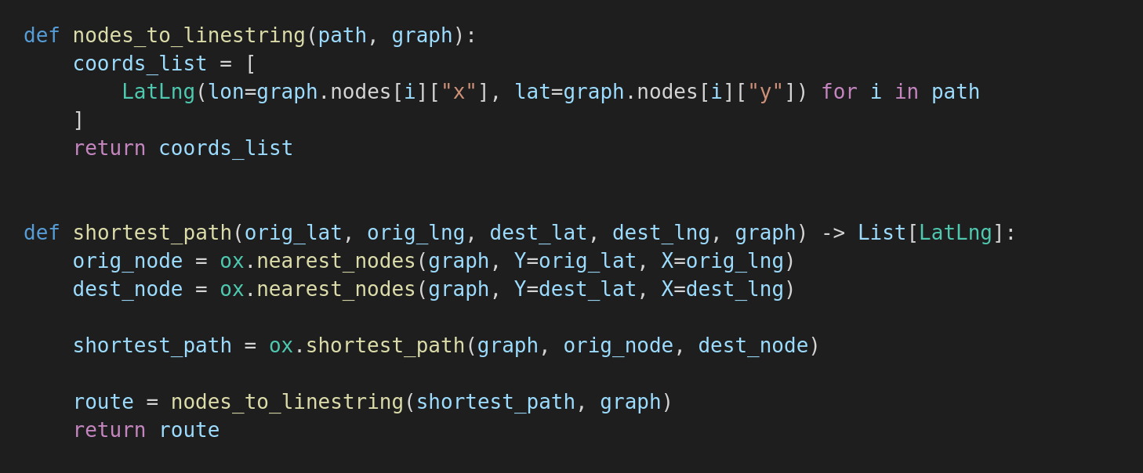
Shortest Path function
This function will take the origin and destination coordinates, the graph we downloaded and use osmnx, then returns a list of LatLng which is just a class containing lon and lat.
The nodes_to_linestring function iterates over the graph’s nodes extracting the x,y values giving us access to coordinates.

Slide 14
Shortest K routes function
Similar to shortest_path but returns a list of nodes which we iterate over returning a list of k number of shortest routes.

Slide 15
Code on Github
The code for all this is available in the repository: https://github.com/bettdouglas/openstreetmap_shortest_path_osmnx/
Fork it.
Play with it.
Create something awesome with it.
Open an issue.
Star it.

Slide 16
About Me
I’m a mobile developer at Crop Nutrition Laboratories. I build mobile applications but love to play around with geospatial things.
Let’s Connect via Social Media:
Twitter -> https://twitter.com/bettdoug/
LinkedIn -> https://www.linkedin.com/in/douglas-bett-842a64b1/
GitHub -> https://github.com/bettdouglas/
PS: I’m open to working on geospatial projects. Let’s connect and see how we can use spatial to solve problems.

