Slide 1
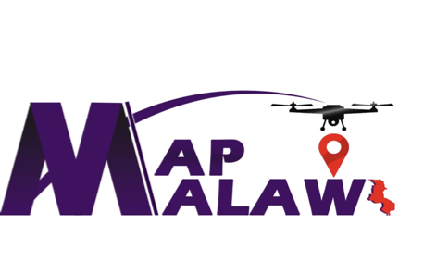
Dzaleka Mapping Project
OSM Mapping for People Living in Protracted Crisis
mapsmalawi@gmail.com

Slide 2
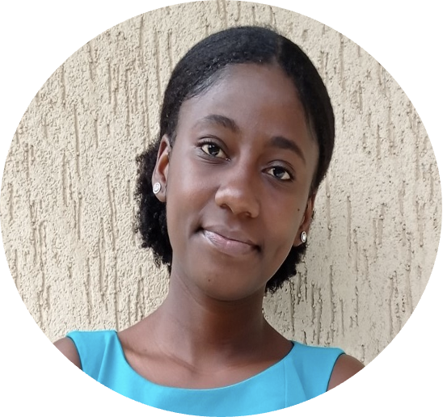
Founded in December 2020 by Ndapile Mkuwu and Zola Manyungwa.
YouthMappers Leadership Fellowship Program and African Drone and Data Academy (ADDA)alumni .
Ndapile - Instructor at the African Drone and Data Academy (ADDA) and a YouthMappers Regional Ambassador.
Zola - Instructor at the University of Malawi and Graduate Research Assistant (GRA) at West Virginia University.
Ndapile Mkuwu
Zola Manyungwa
Notes:
MapMalawi is a newly established non-governmental organization (NGO) , founded in December 2020 by two Malawian girls, Ndapile Mkuwu and Zola Manyungwa. The two are affiliated with the YouthMappers network and are alumni of the YouthMappers Leadership Fellowship Program. Ndapile is currently an instructor at the African Drone and Data Academy and a YouthMappers Regional Ambassador. Zola is currently a member of staff at the University of Malawi and Graduate Research Assistant (GRA) at West Virginia University.

Slide 3
Mission
Create, engage, and work with youth-based communities in the creation of open-source geospatial data, using Geospatial technology, as one of the means of contributing towards addressing local developmental and humanitarian issues in Malawi.
Notes:
Our mission is to create, engage, and work with youth-based communities in the creation of open-source geospatial data using Geospatial technology as one of the means of contributing towards addressing local developmental and humanitarian issues in Malawi

Slide 4
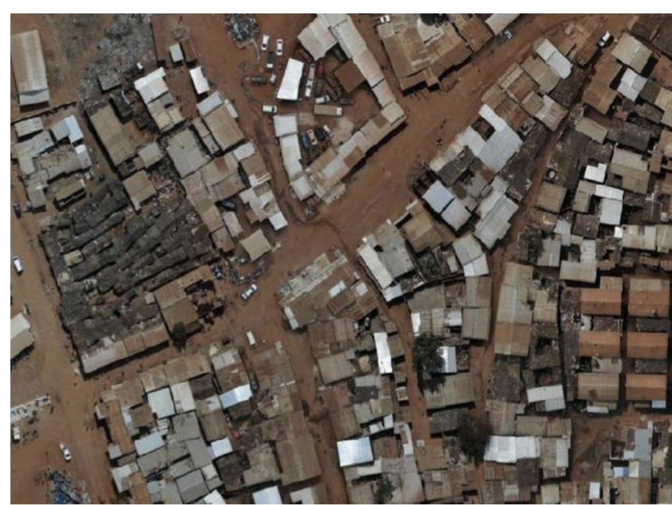
Dzaleka Refugee Camp
Dzaleka refugee camp is the largest camp in Malawi.
Designed to house 10,000 refugees and asylum seekers but currently has more than 43,000.
Increase in the demand for already inadequate resources in the camp.
Source: Map Malawi 2021
Notes:
Dzaleka refugee camp is the largest camp in Malawi, located 50km just outside the capital city, Lilongwe. Established in 1994 by UNHCR in response to a surge of forcibly displaced people, it is designed to house 10,000 people. However, it has surpassed the maximum absorption and has more than 43,000 refugees and asylum seekers. The increase population translates to an increase in the demand for already inadequate resources in the camp.

Slide 5
Dzaleka Mapping Project
Funded
Facebook’s Humanitarian OpenStreetMap Team (HOT) Community Impact Grant
Aim
Generate geospatial data to show the provision of basic needs.
How?
Integrating drones, OpenStreetMap and other geospatial technologies to map out centers of basic needs access.
Centers
Education, health care, water/sanitation, and buildings/housing.
Notes:
The Dzaleka Mapping Project aims at generating geospatial data that will show the provision of basic needs at the refugee camp by integrating drones, OpenStreetMap and other geospatial technologies. Centers within or around the refugee camp that allow the refugees to have access to the different basic needs will be mapped out. These include: education, health care, water/sanitation, and buildings/housing. The relevant statistics of the mapped amenities will present a picture of the extent to which people living in the camp have access to the different amenities.

Slide 6
Tools and Technology
UAV (Drones)
HOT Tasking Manager
Collecting imagery with resolution of upto 3 cm/pixel
Coordination of volunteers to map on OpenStreetMap
iD editor
Digitizing features from imagery
KoBoCollect
Participatory GIS
QGIS
Analysis and final map output

Slide 7
Youth Involvement
Goal
To strengthen technological capabilities and encourage young professionals to creatively use geospatial technology to address in their communities.
Two youthbased groups are involved
MapMalawi volunteers recruited from African Drone and Data Academy (ADDA)
Youth living within and around the refugee camp and are affiliated with a local tech-lab called TakenoLab (info@takenolab.com )
Notes:
Two youthbased groups are involved in the project.
The first group consists of graduates from the African Drone and Data Academy (ADDA), that hold Bachelor Degrees from different Malawian universities. These people are now MapMalawi volunteers.
The second group consists of young people that live within and around the refugee camp and are affiliated with a local tech-lab called TakenoLab.
The goal behind youth involvement is to strengthen their technological capabilities and to encourage young professionals to creatively use geospatial technology to address in their communities.

Slide 8
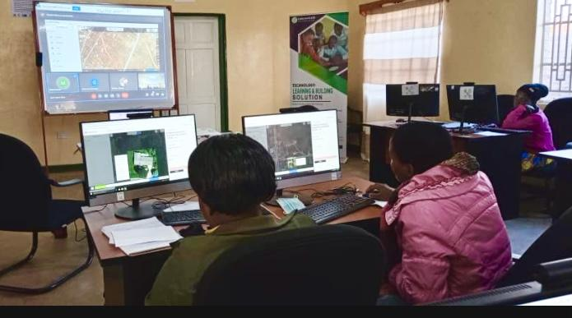
Community Training and Impact
Capacity Building
Trained 46 people on mapping with iD editor.
Two MapMalawi Volunteers and 25 people from Dzaleka were introduced to drone technology.
Two people living within the refugee camp were trained on data collection using KoBoCollect.
Feedback
The youth from the Dzaleka Refugee Camp and TakenoLab expressed that they are now enlightened and open to applying open geospatial technology i.e. to highlight the need of a market place and electrification.
Notes:
Impact
One of the major impacts of the project so far is capacity building
A total of 46 people from the two youthbased groups were train on how to map using iD editor.
Two MapMalawi Volunteers were introduced to drone technology. This involved the introduction of different components of drones, flying and also mission planning
Feedback
The youth from the Dzaleka Refugee Camp and TakenoLab expressed that they are now enlightened and open to applying open geospatial technology in different areas at the camp i.e. to highlight the need of a market place and electrification.

Slide 9
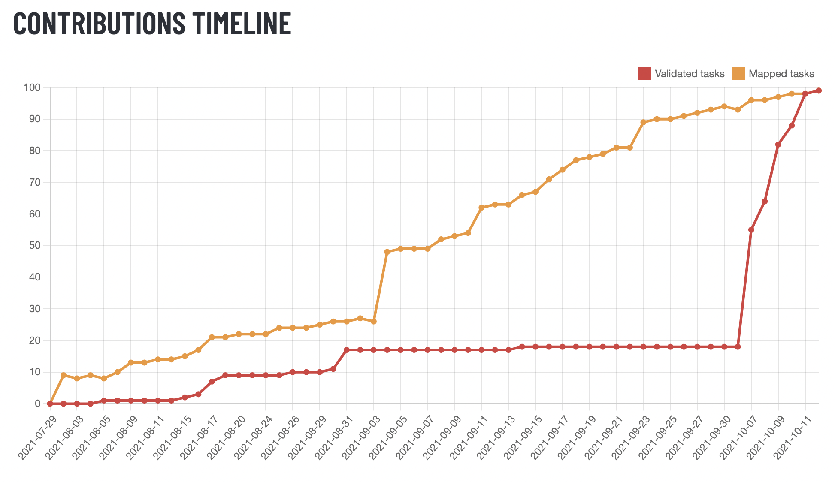
Where are we now?
With the assistance of the OSMAfrica community, Dzaleka mapping community. MapMalawi volunteers and the HOT Data Interns, the project is completely mapped and validated
11,687 new edits

Slide 10
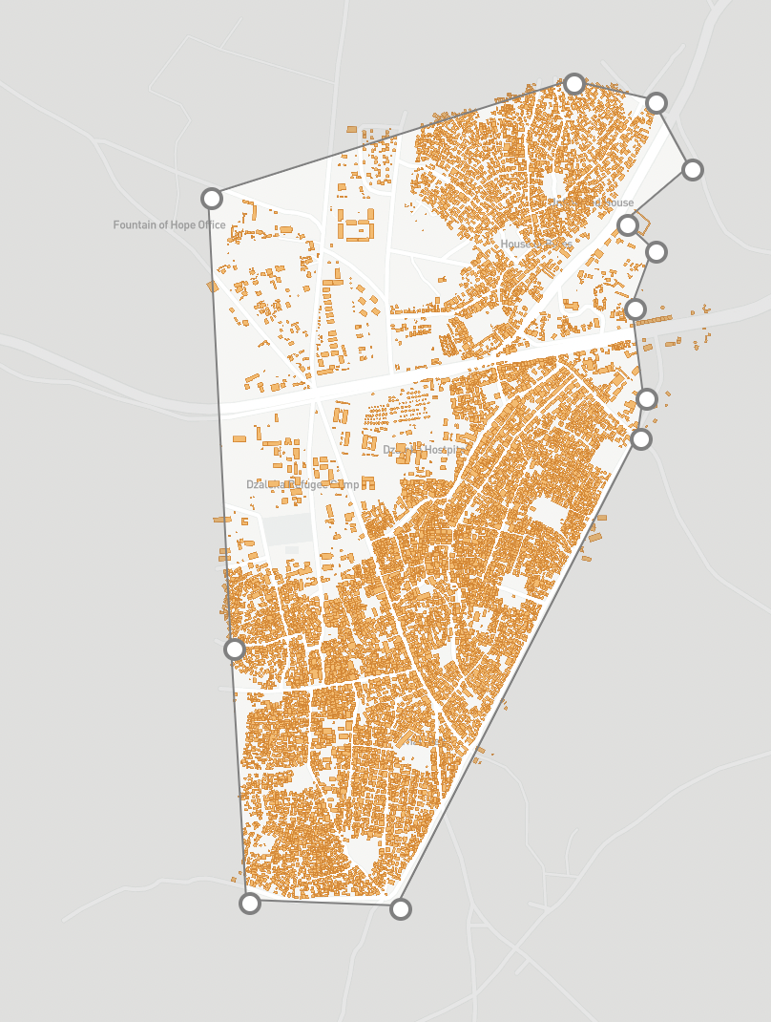
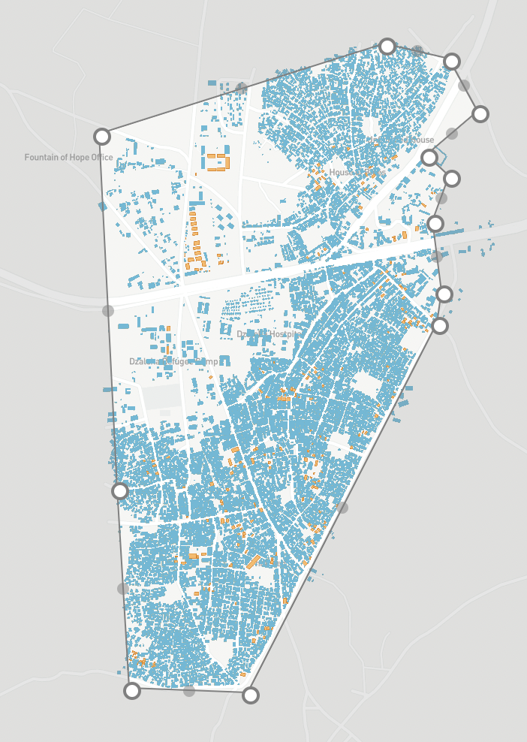
Orange- Mapped out buildings
Blue- Buildings mapped under the project. From July 2021 to present

Slide 11
Lessons learnt
Collaboration makes the dream work.
Quick adaptation, especially now with the pandemic.
Community involvement and partnerships are key to a projects success
Youth are eager to learn about new technology and their applications, but there are limited opportunities for them to do so.
The cost of GIS technologies and the internet are significant barriers to entry
Notes:
Community involvement and partnerships are key to a project's success- TakenoLab, our local partner at Dzaleka refugee camp has helped us mobilize eager and willing youth to contribute and be part of the project, and this is a group that is made up of people that are more knowledgeable of our study area and know what kind of problems they encounter on a day to day basis. Whereas the African Drone and Data Academy has helped us tremendously in acquiring the necessary documentation in terms of authorizations to fly and authorization from the ministry of homeland security.

Slide 12
WHAT NEXT?

