Slide 1
Patricia Solís, PhD Director and Co-Founder, YouthMappers Executive Director, Knowledge Exchange for Resilience Associate Research Professor, School of Geographical Sciences and Urban Planning Arizona State University patricia.solis@asu.edu
Defining our world by mapping it
Lessons to learn from YouthMappers and the
OpenStreetMap community of communities

Slide 3
Look around.
Find the best of humanity.

Slide 4
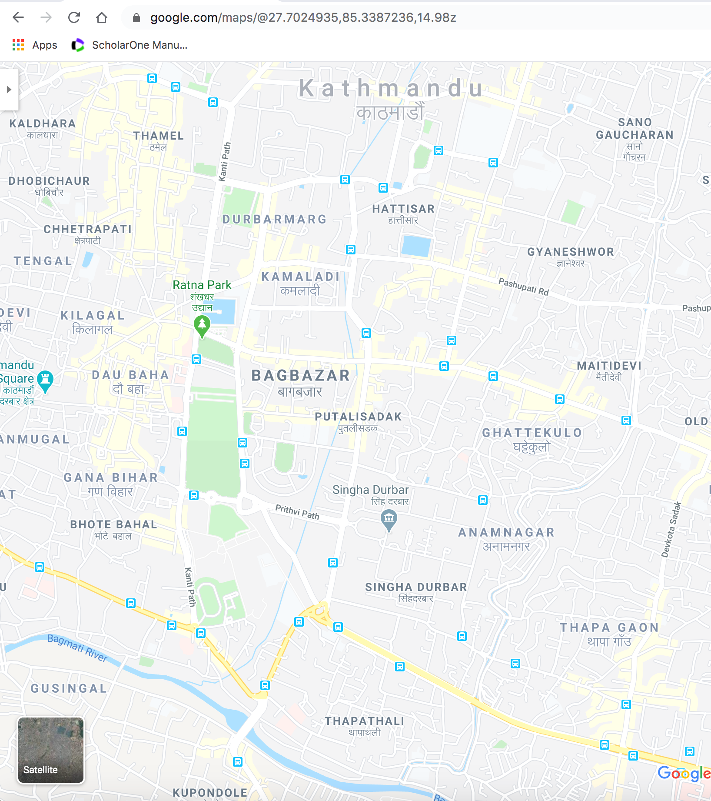
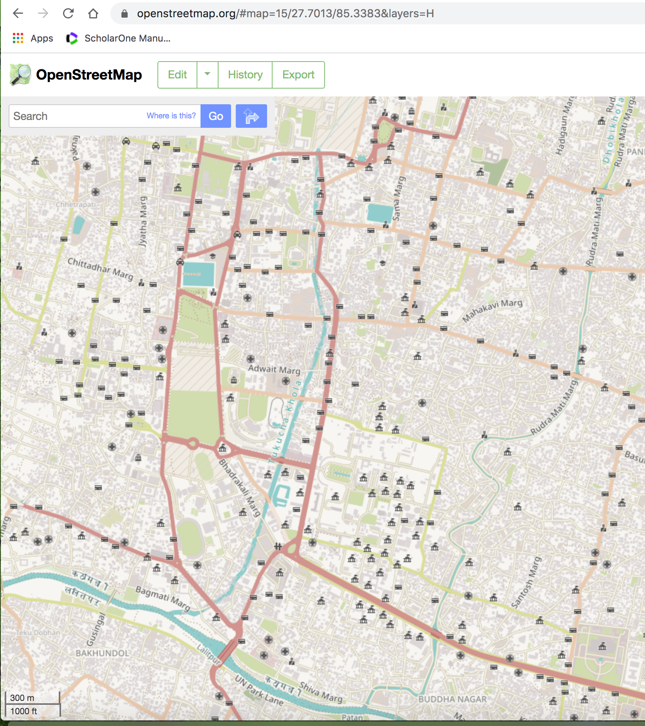

Slide 5
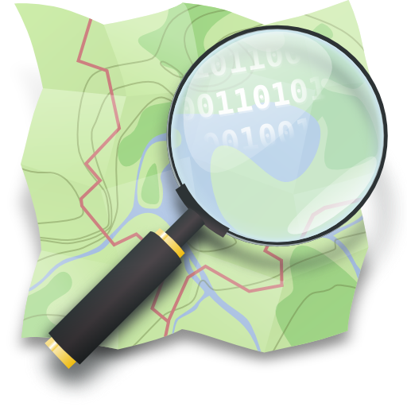
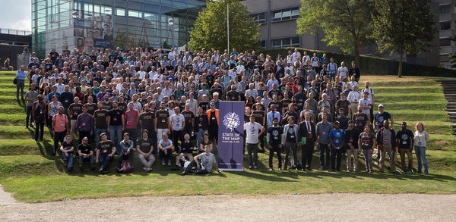
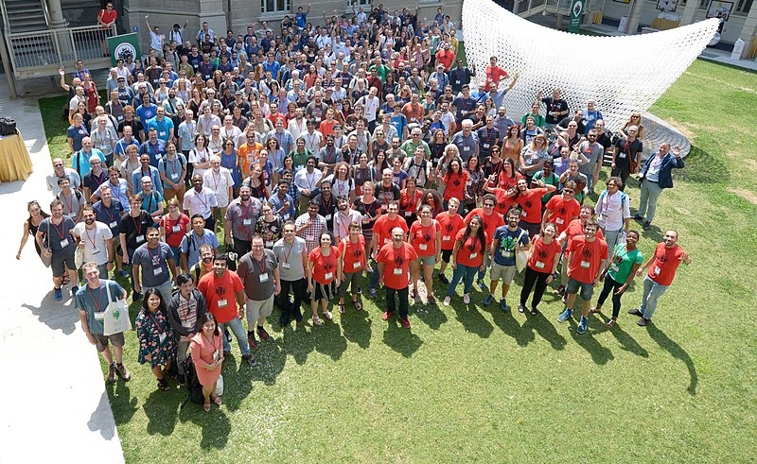
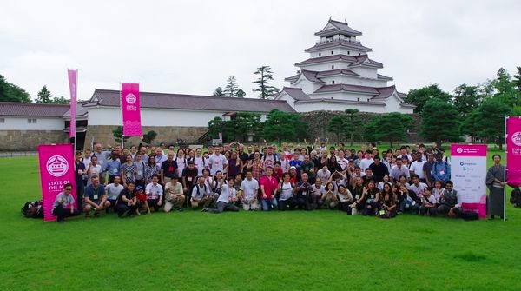
OpenStreetMap Community
“community of communities”

Slide 6
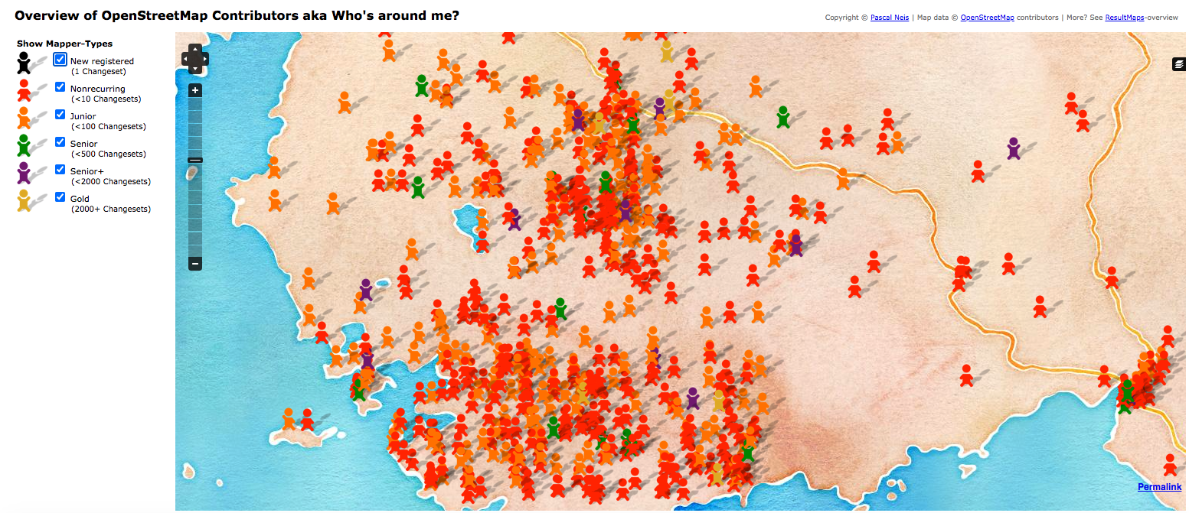
“Community of communities”

Slide 7
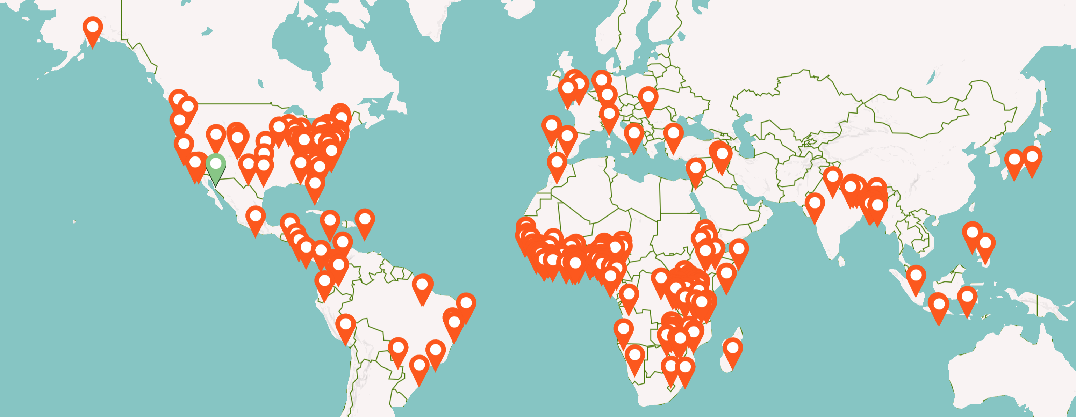
A global consortium of student-led faculty-mentored campus-based chapters creating open maps for real-world humanitarian and development projects
291 universities
in 62 countries
Chapters Network Structure

Slide 8
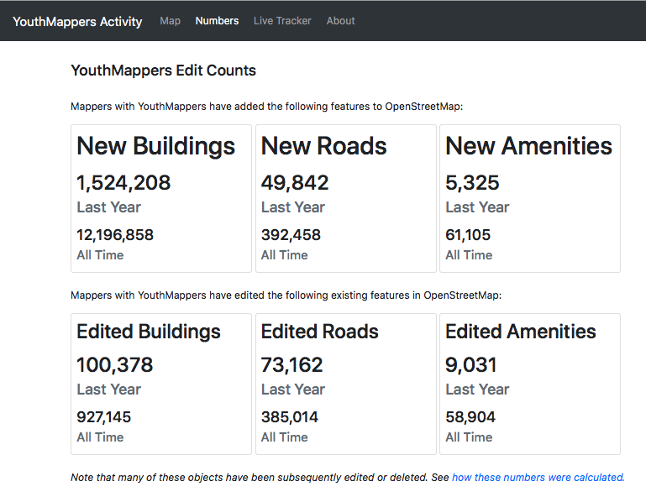
“Community of communities”
45% are in Africa
Credit: Jennings Anderson for YouthMappers © 2021

Slide 9
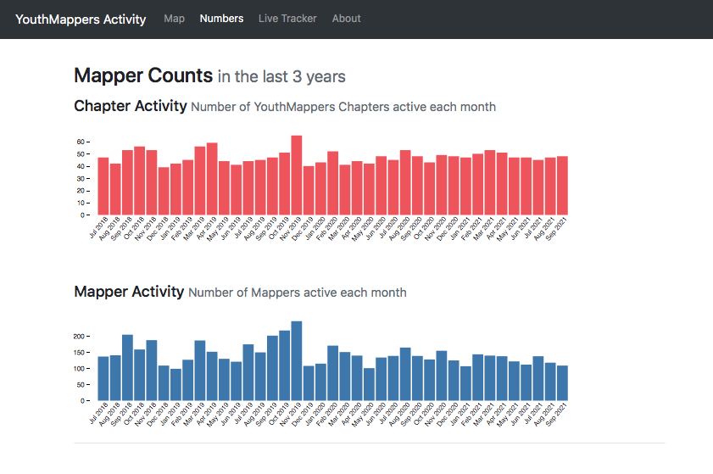
“Community of communities”
45% are in Africa
Credit: Jennings Anderson for YouthMappers © 2021

Slide 10
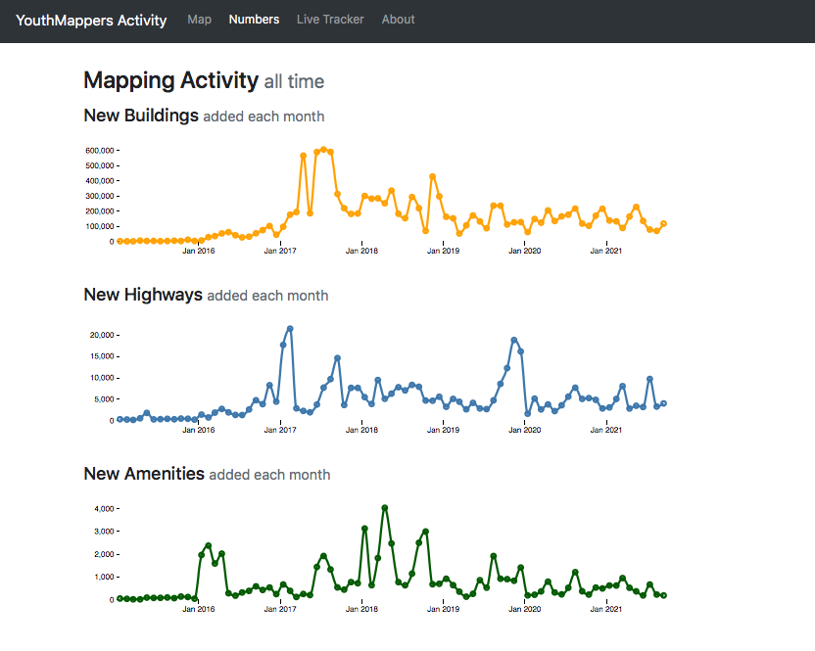
“Community of communities”
45% are in Africa
Credit: Jennings Anderson for YouthMappers © 2021

Slide 11
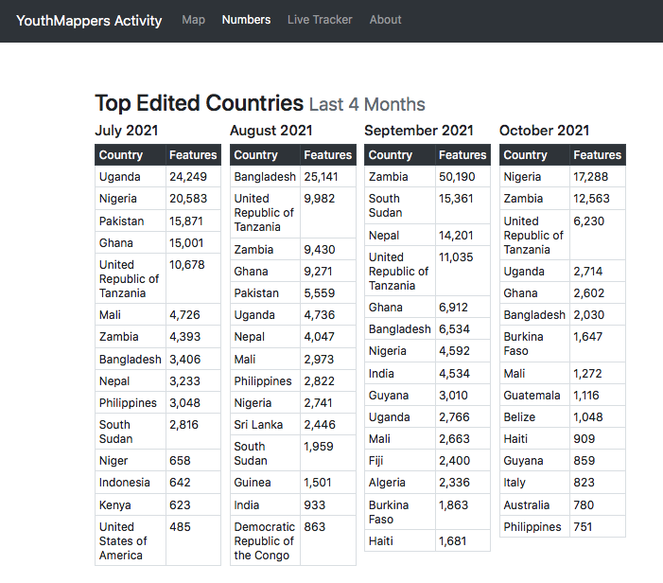
“Community of communities”
45% are in Africa
Credit: Jennings Anderson for YouthMappers © 2021

Slide 12
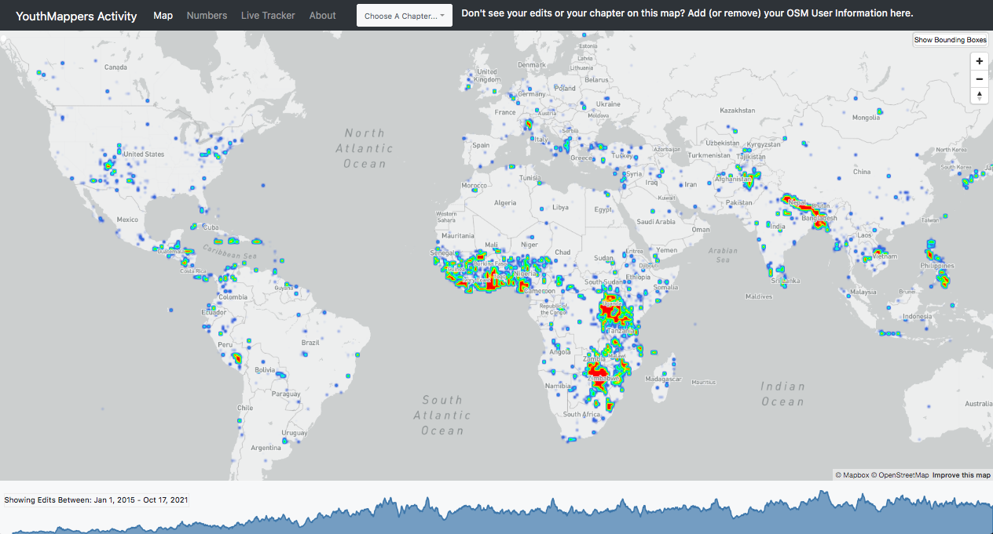
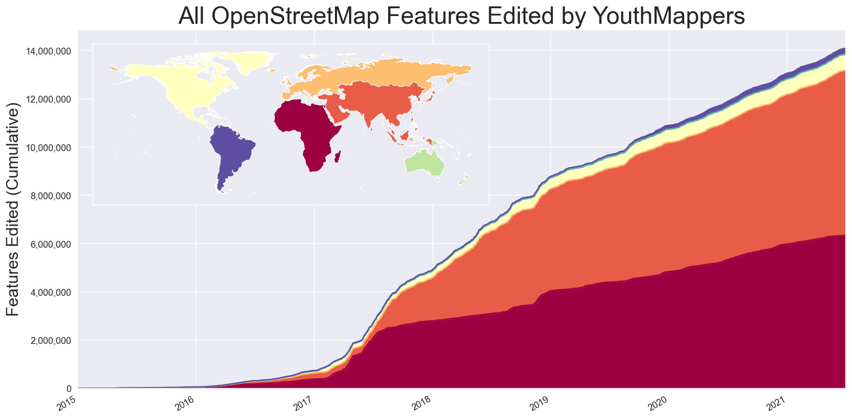
“Community of communities”
45% are in Africa
Credit: Jennings Anderson for YouthMappers © 2021

Slide 13
“Community of communities”
45% are in Africa
Credit: Jennings Anderson for YouthMappers © 2021

Slide 14
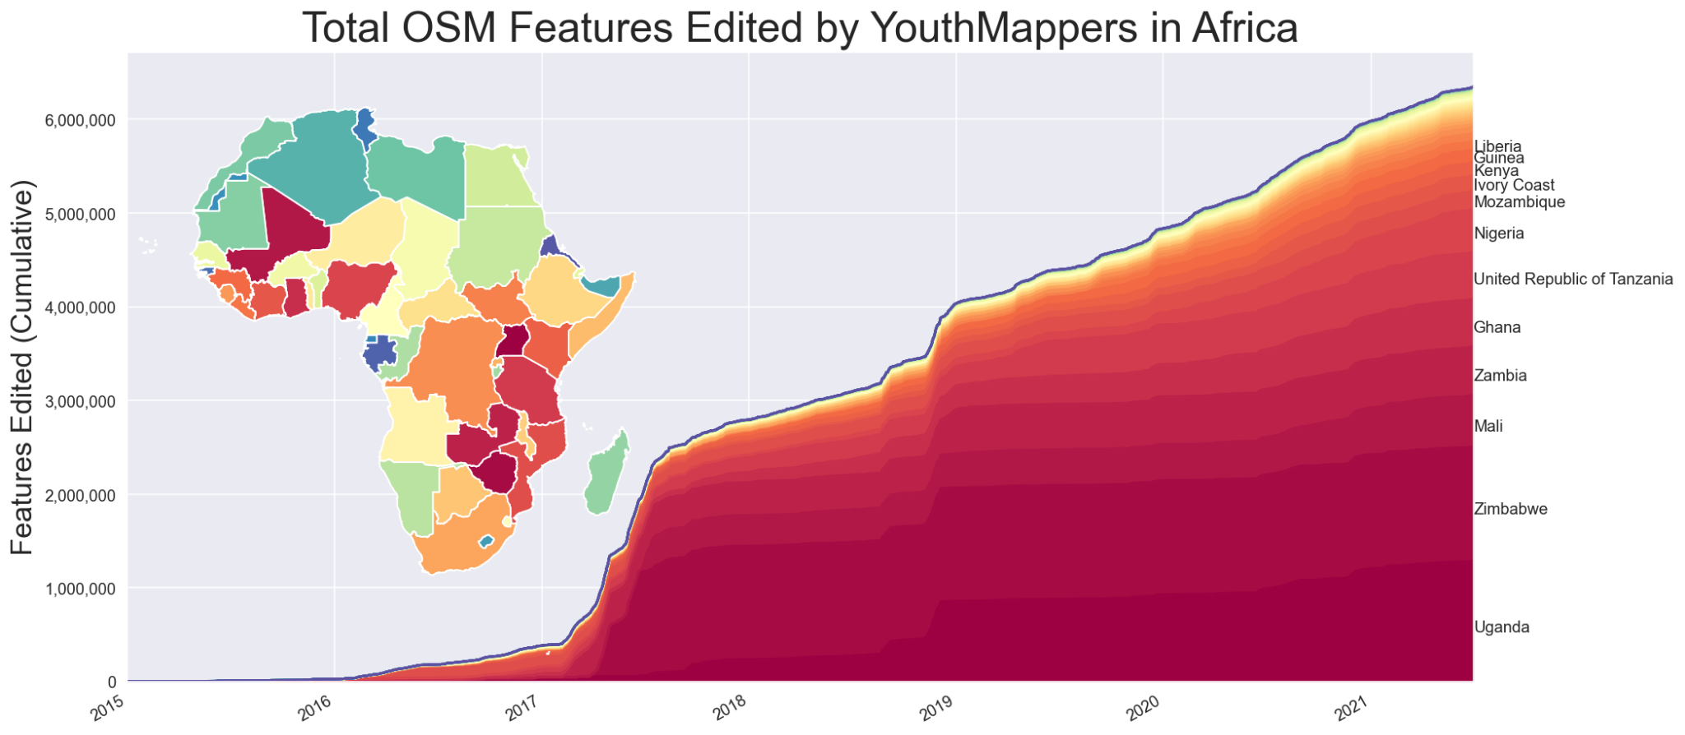
“Community of communities”
Credit: Jennings Anderson for YouthMappers © 2021

Slide 15
we don’t just build maps.
we build
mappers.

Slide 16
Invest in each other.
It pays dividends.

Slide 17
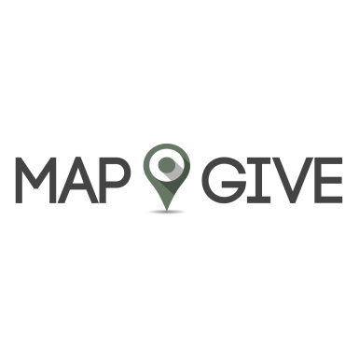

Slide 18
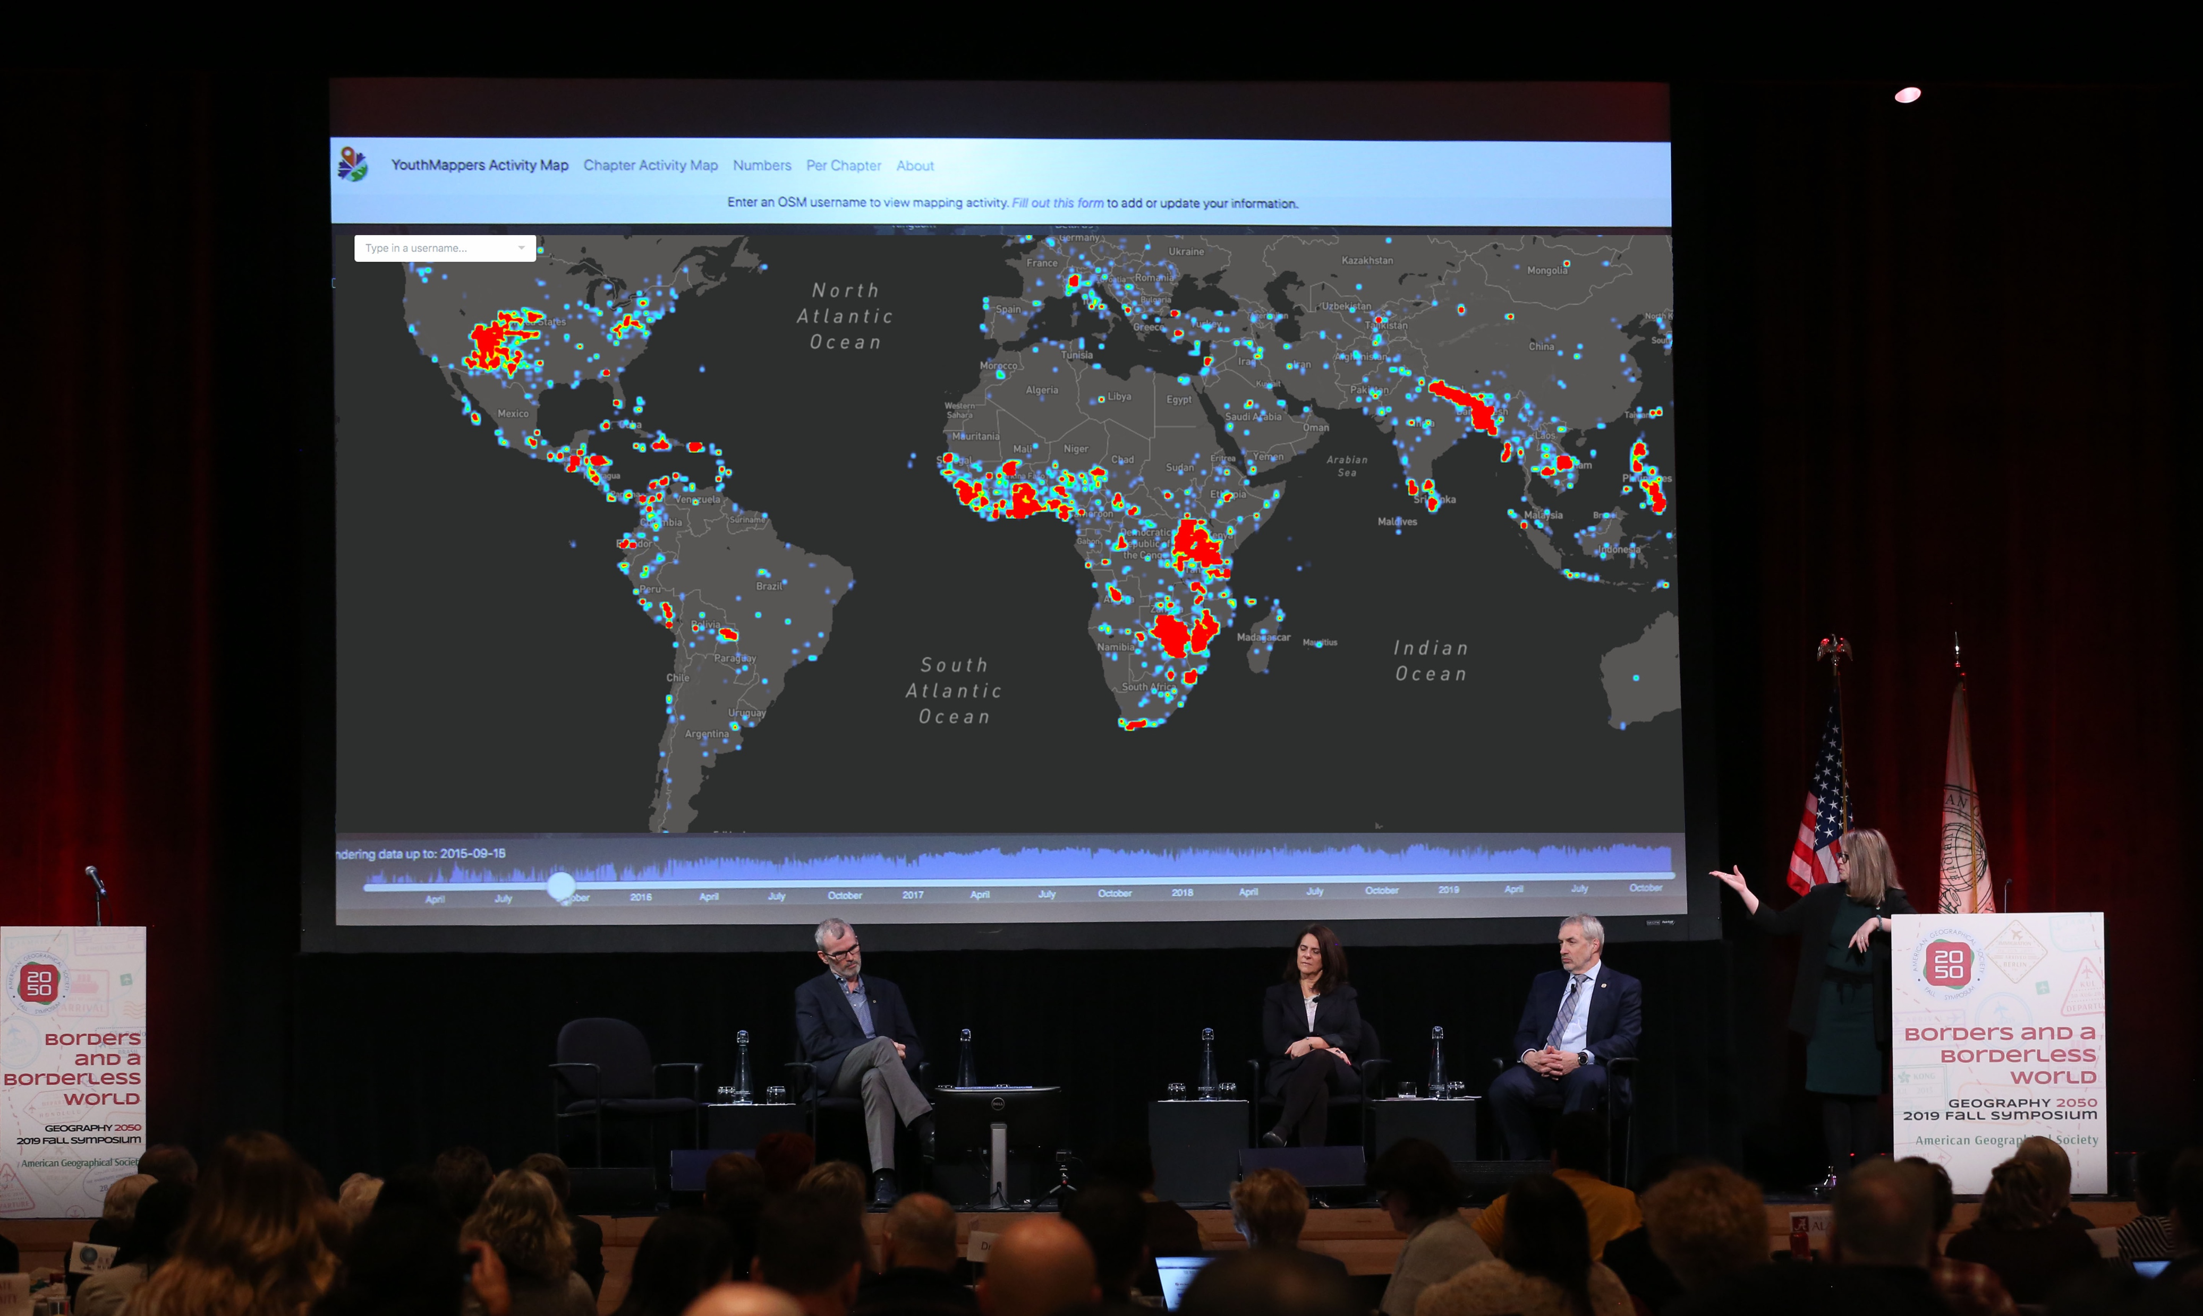
activity.youthmappers.org
Remote Campaigns: collaborate and work in solidarity through mapping the world

Slide 19
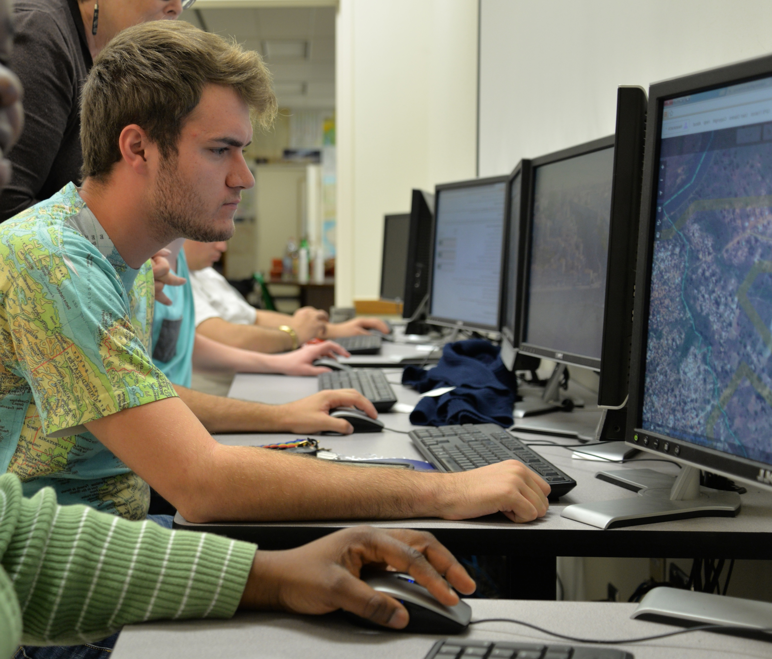
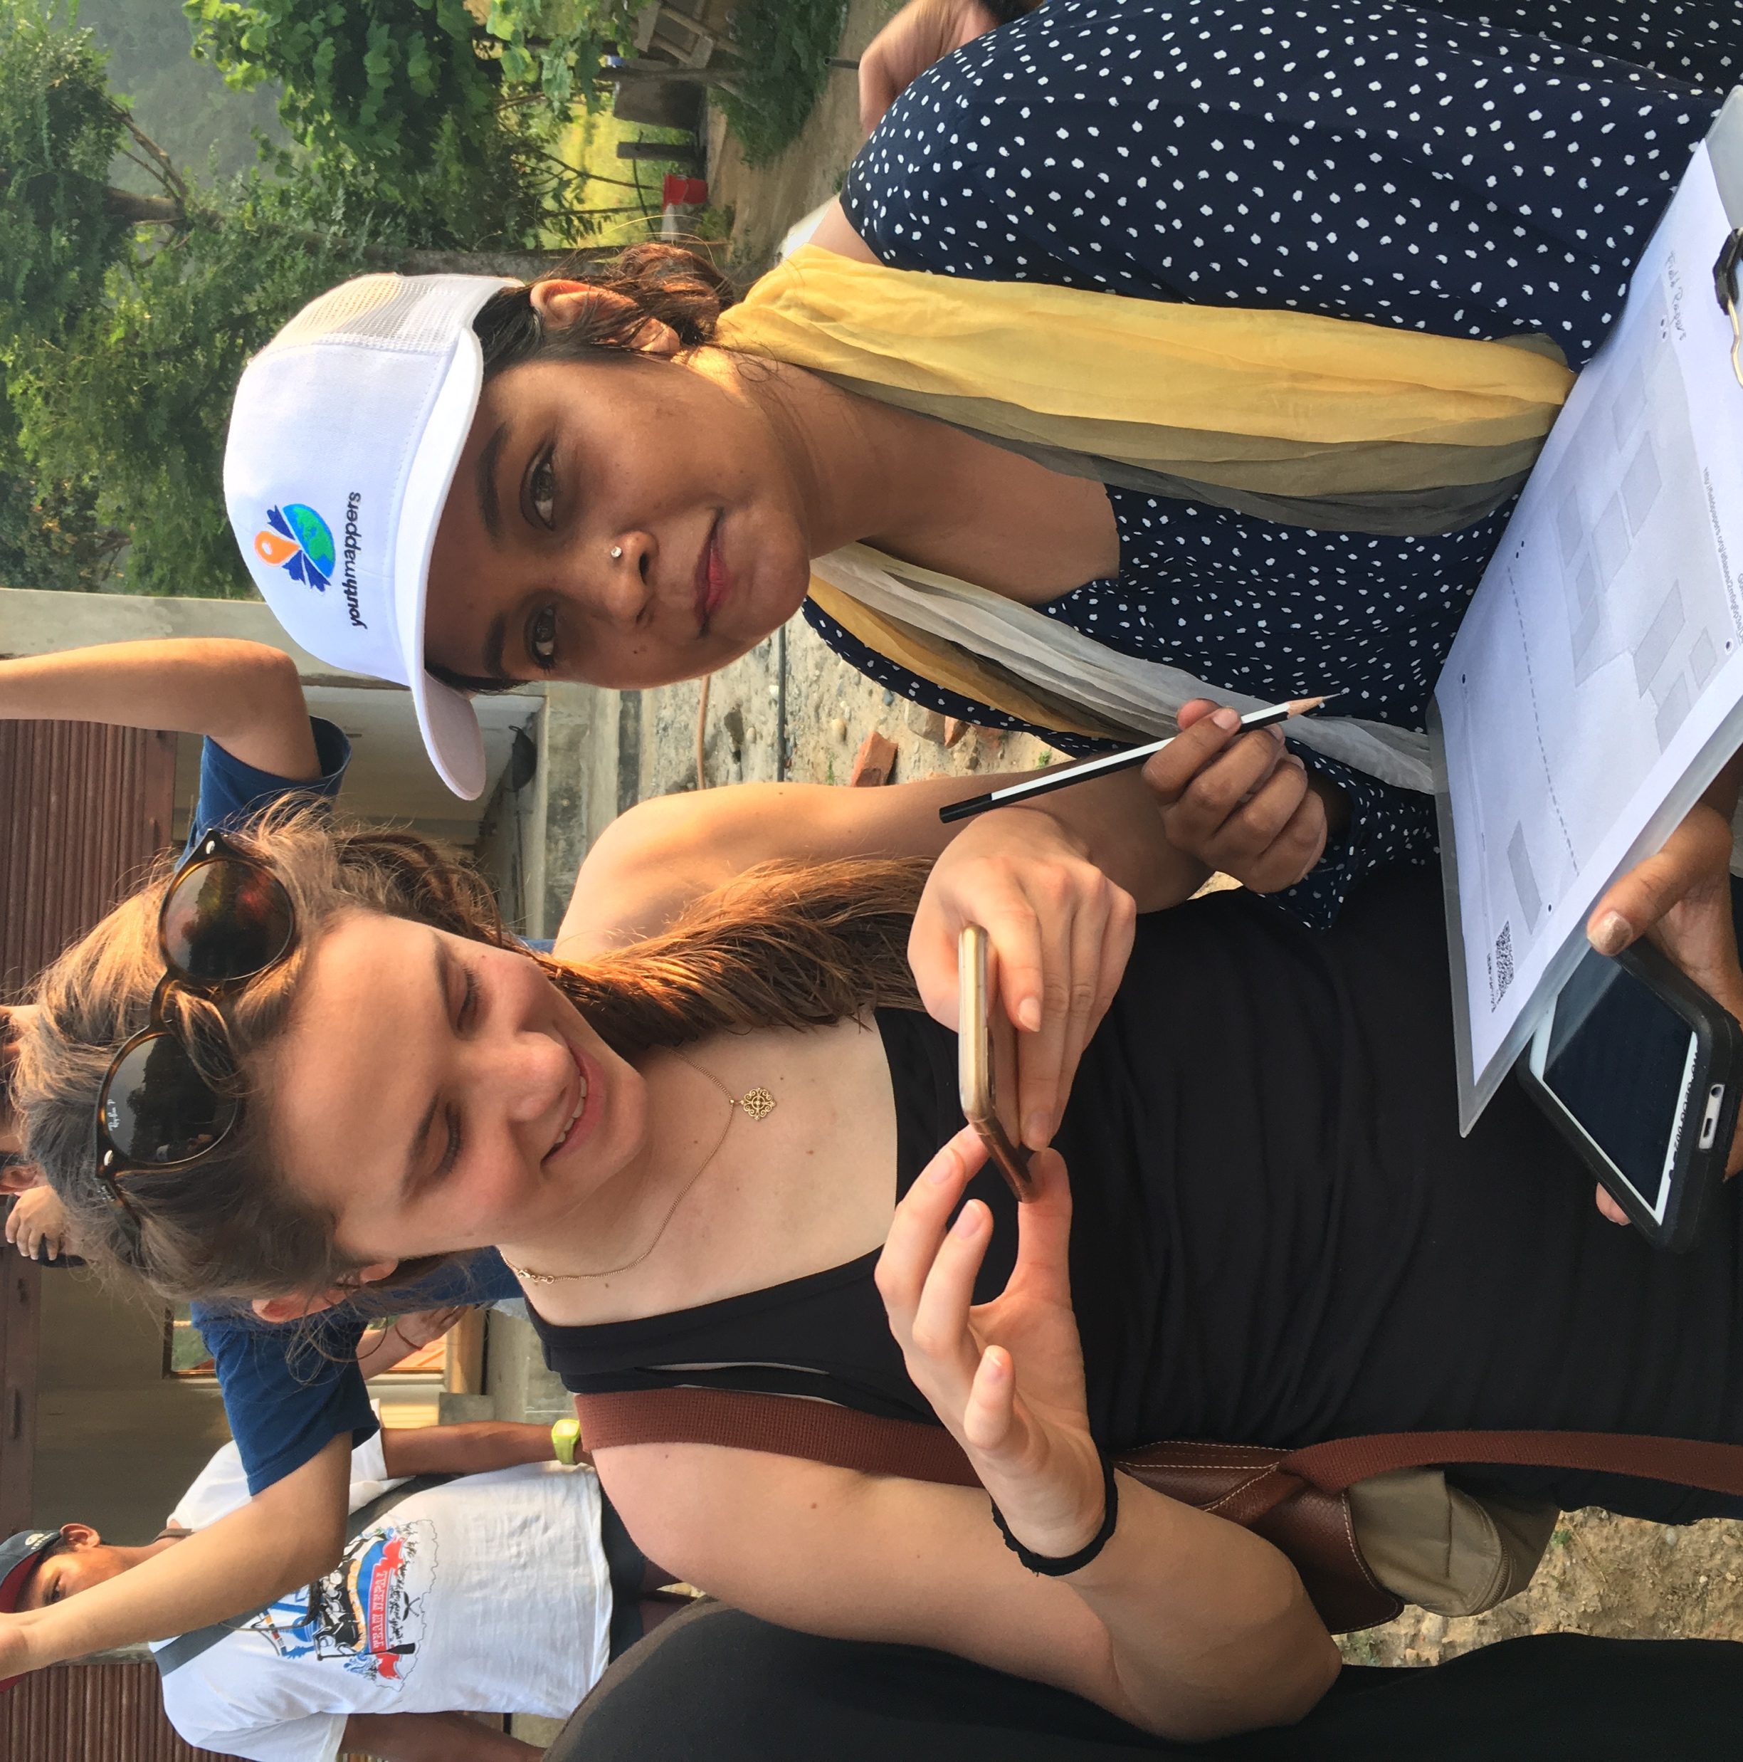
Fieldwork Mini-grants: create your own local data (attributes) or analysis

Slide 20
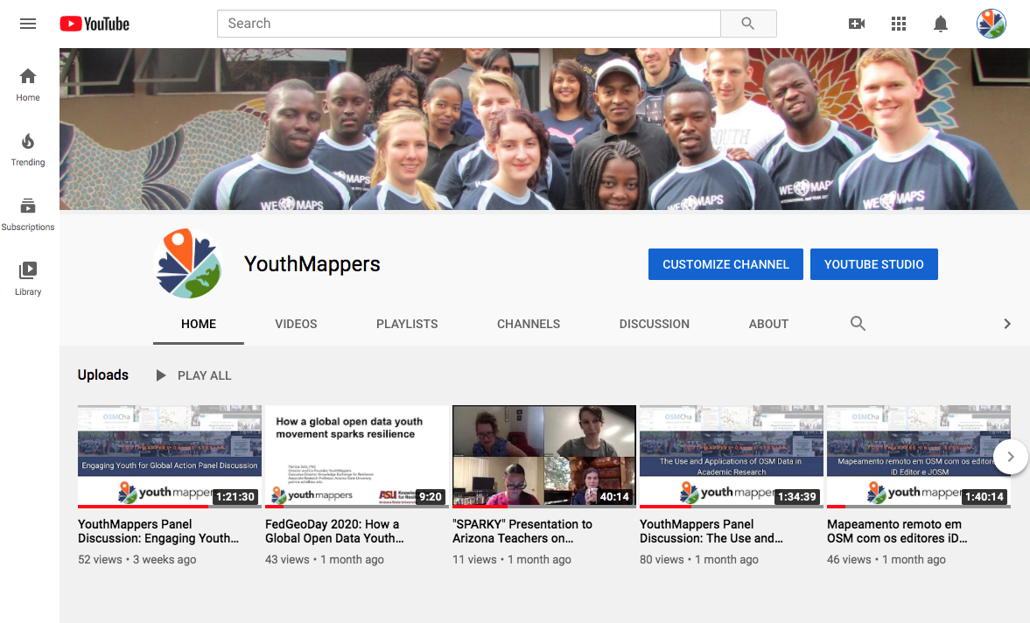
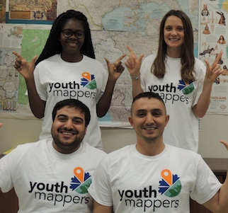
Learn & Share: Trainings, Syllabi, Webinars

Slide 21
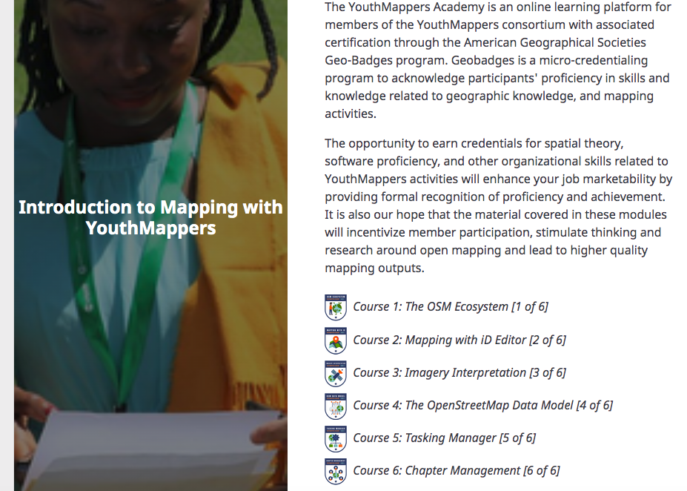
Learn & Share: YouthMappers Academy
https://youthmappers.course.tc/catalog

Slide 22
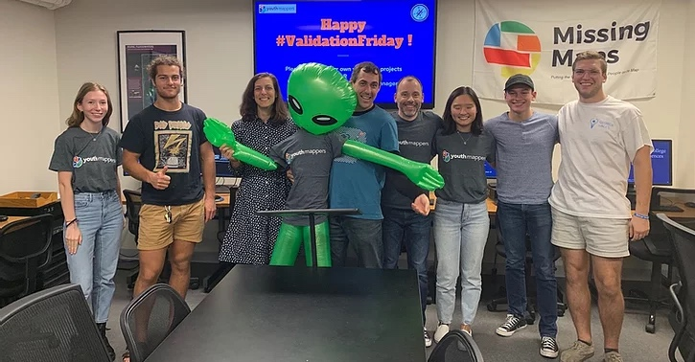
Validation Hub: enjoy an experienced crew looking out for you

Slide 23
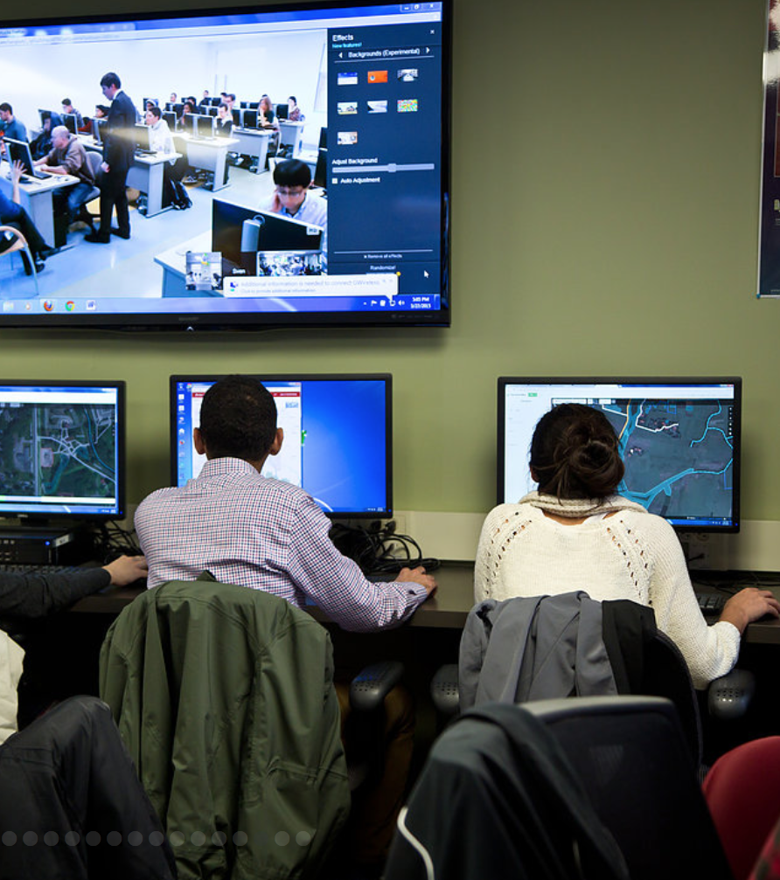
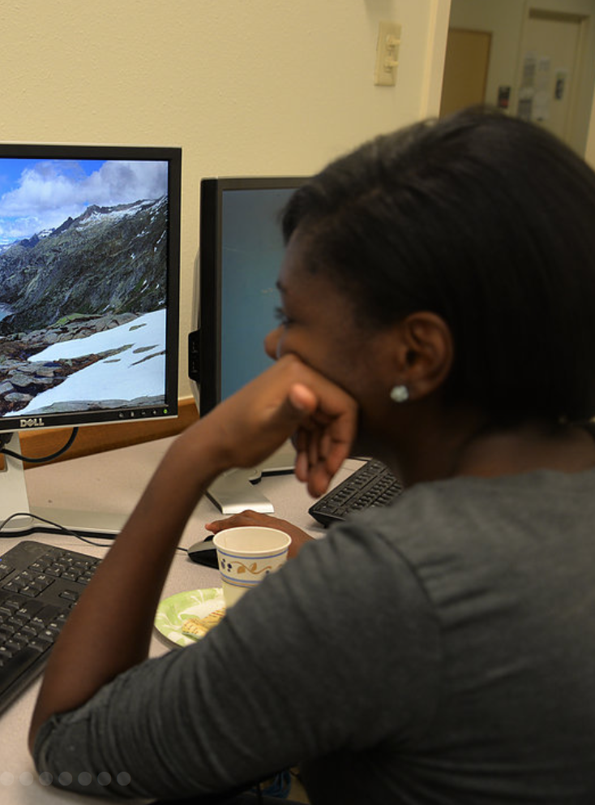
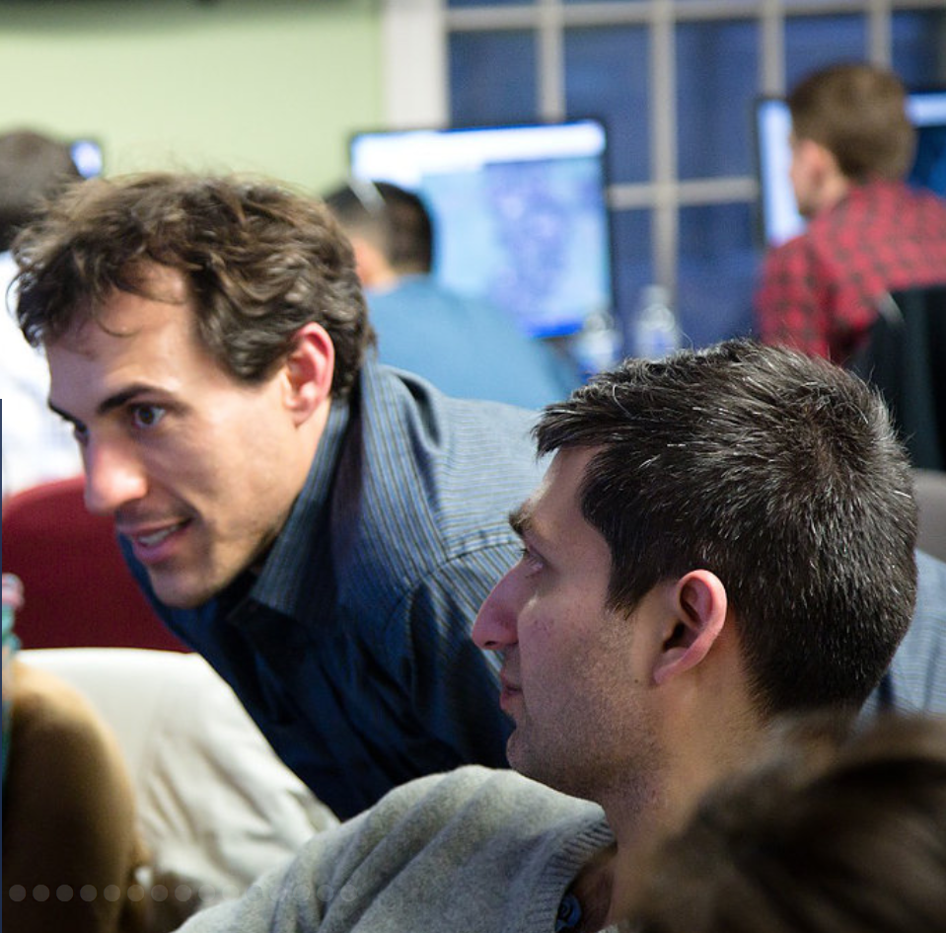
Virtual Internship: experience this novel mechanism for career development

Slide 24
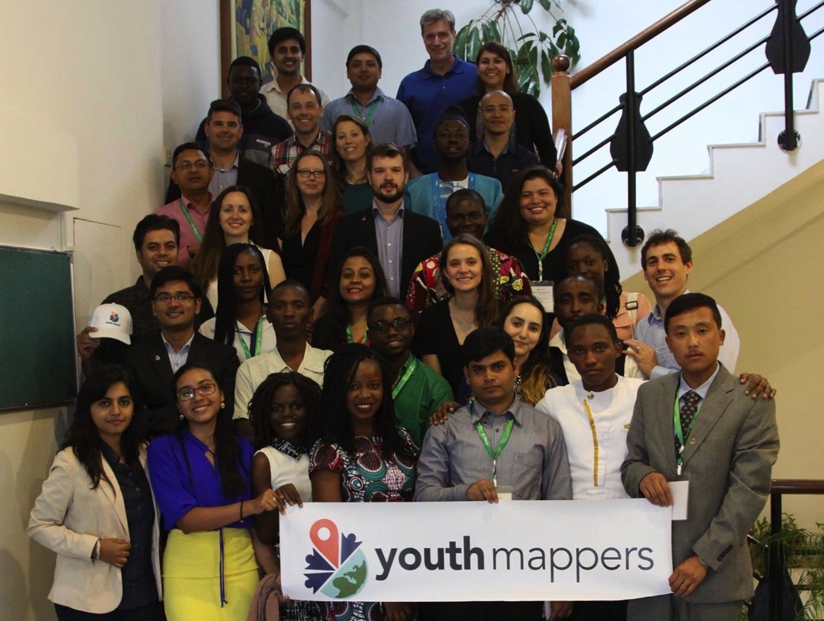
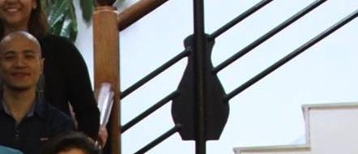
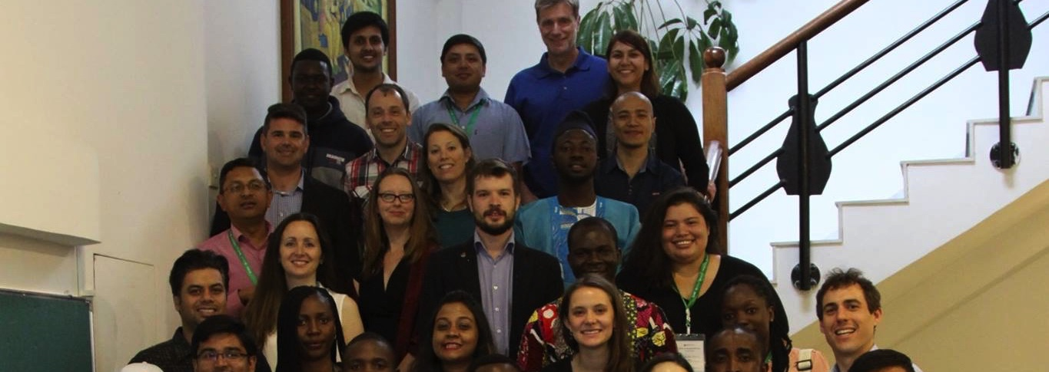
Leadership Fellowship: apply to a Peer Cohort Experience across Continents
Community-building for long term viable mapping infrastructure in the region
Competitive seed funding for added-value activities that increase motivation and sustainability, e.g. research studies
Leverage connections in academic as well as public sector, e.g. secondary end-users

Slide 25
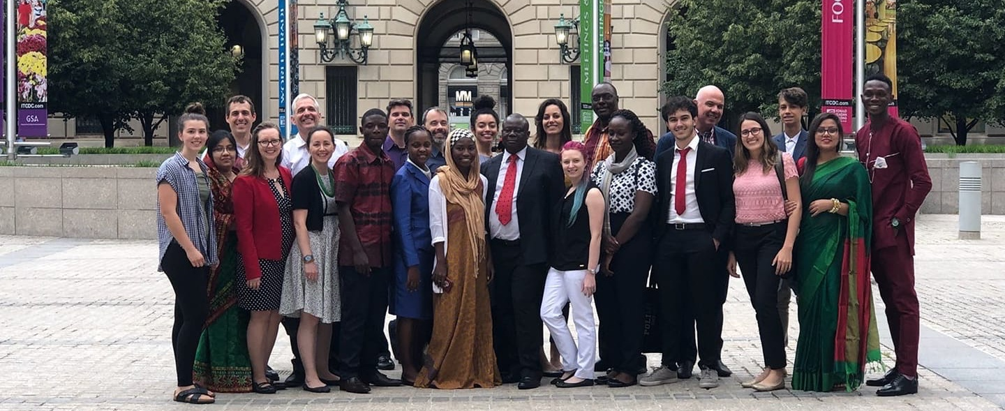
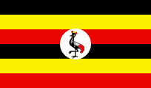
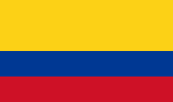
Research Fellowship: Deepen Data Use from Information to Knowledge
Disaster Preparedness, Food Security, Refugee Settlements, Illegal Mining, Flooding Mitigation, Disease Prevention

Slide 26
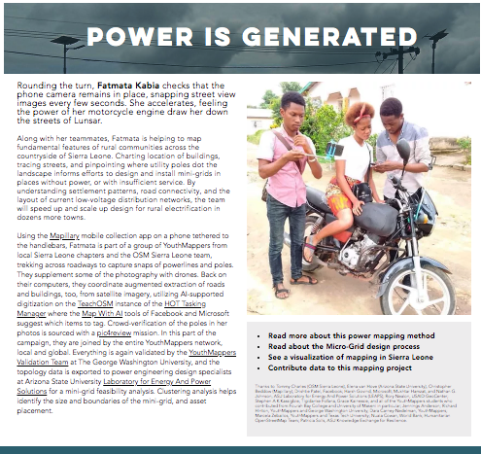
Everywhere She Maps: Increase Women’s participation and amplify mapping projects that address gender issues

Slide 27
Be a good ancestor.
Start by listening to the future.

Slide 28
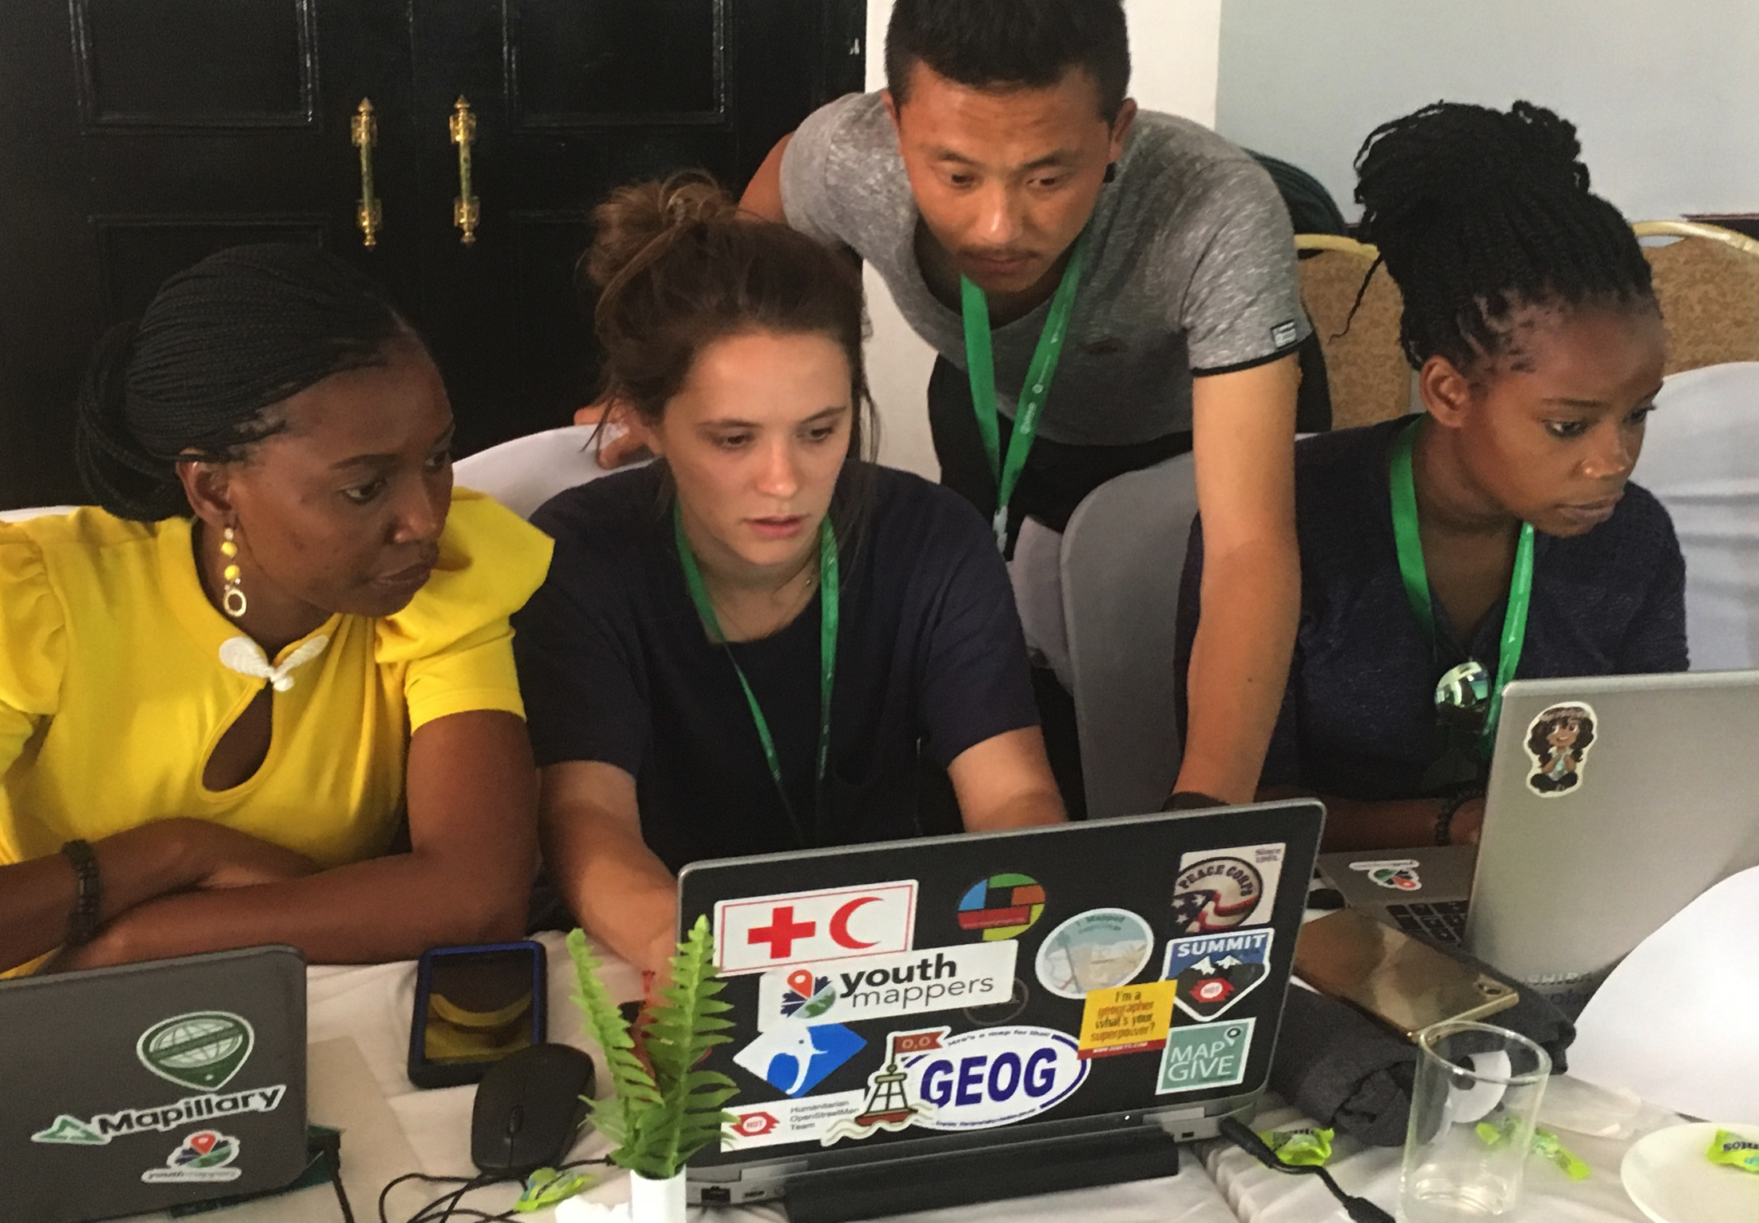
Notes:
The work is performed by the entire YouthMappers network, local and global. It is remotely validated by the YouthMappers Validation Team, led by George Washington University.

Slide 29
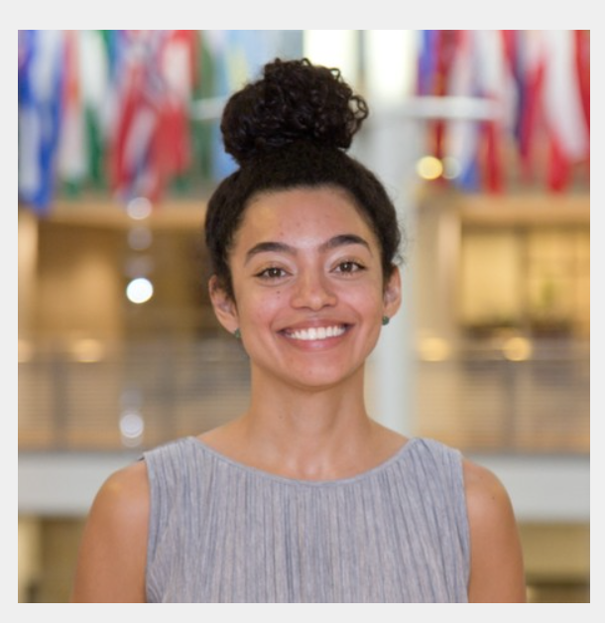
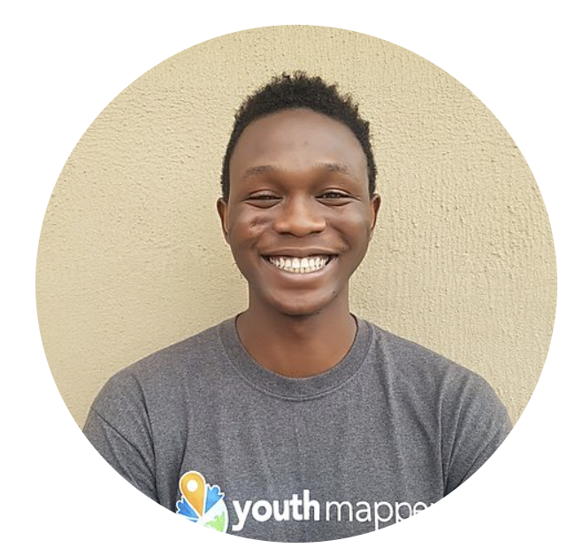
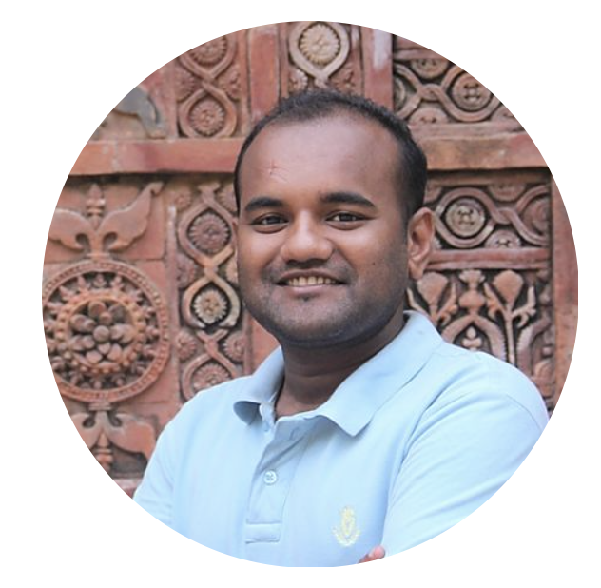
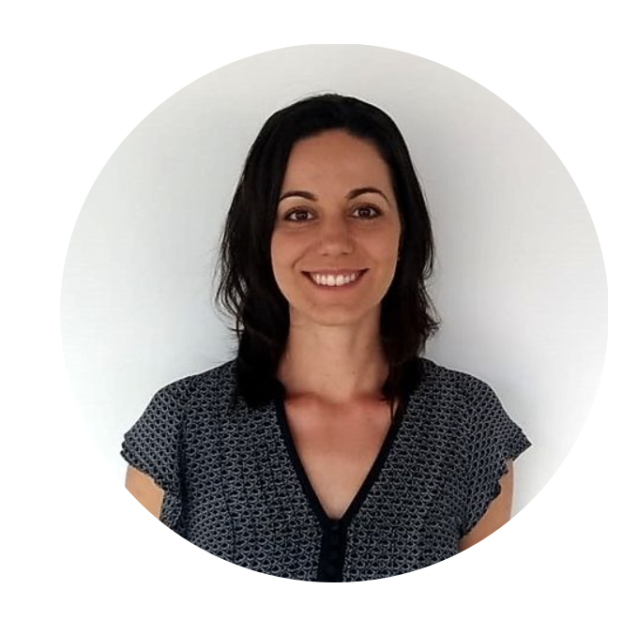
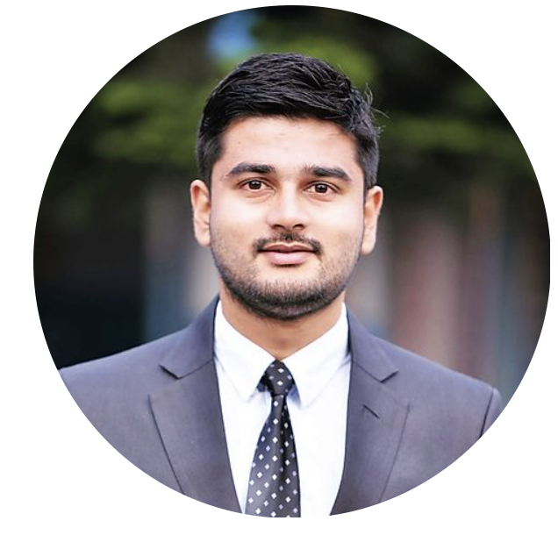
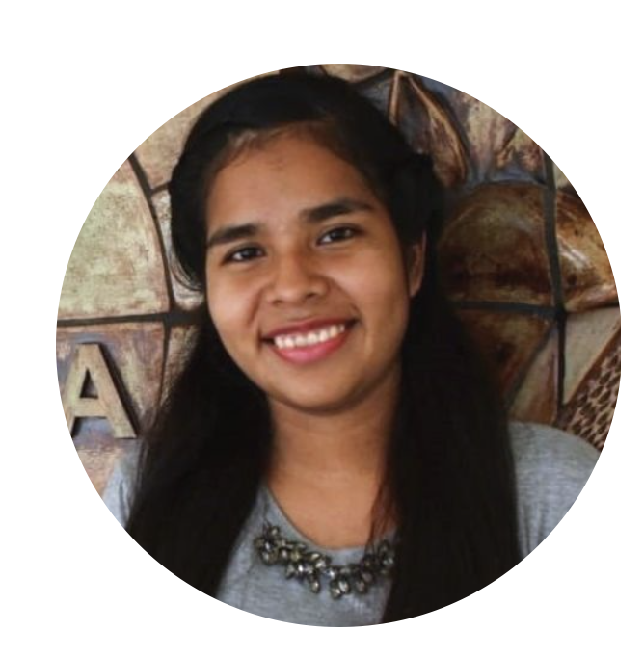
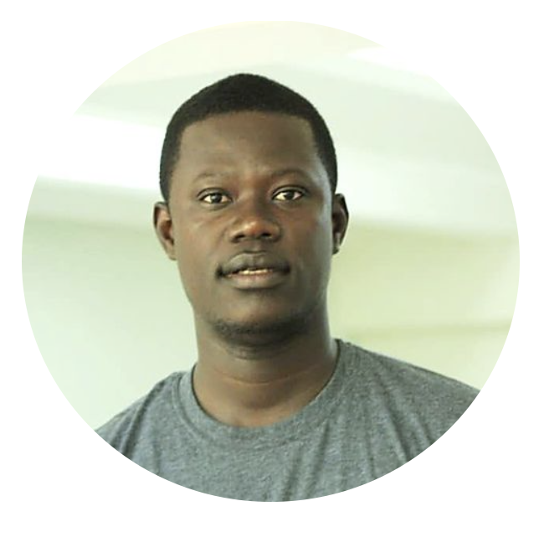
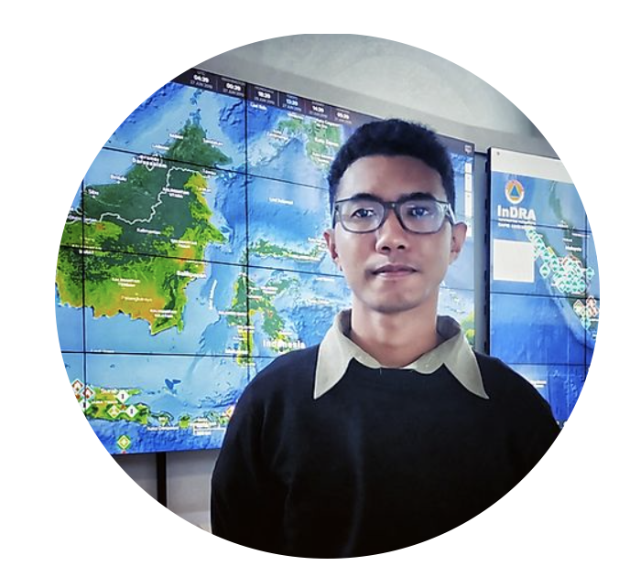
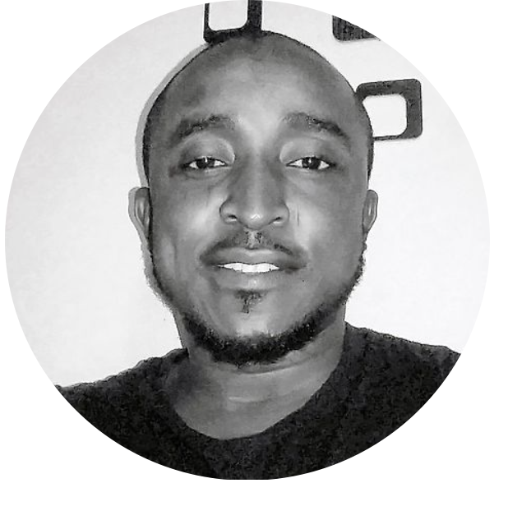
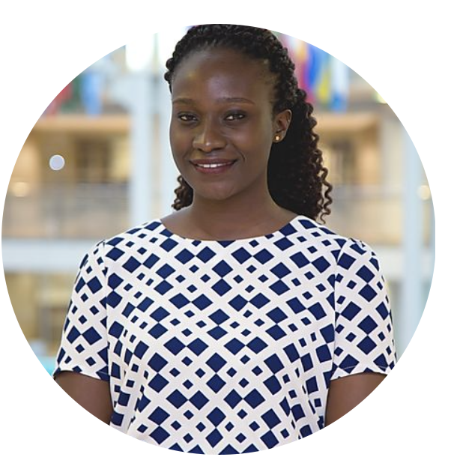
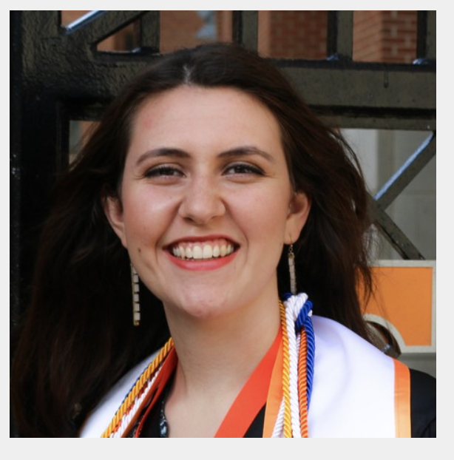
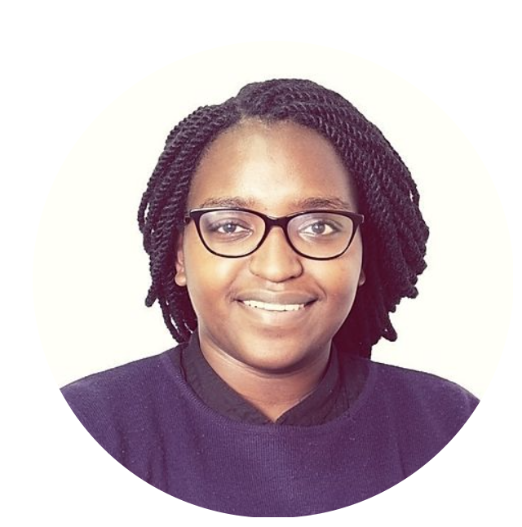
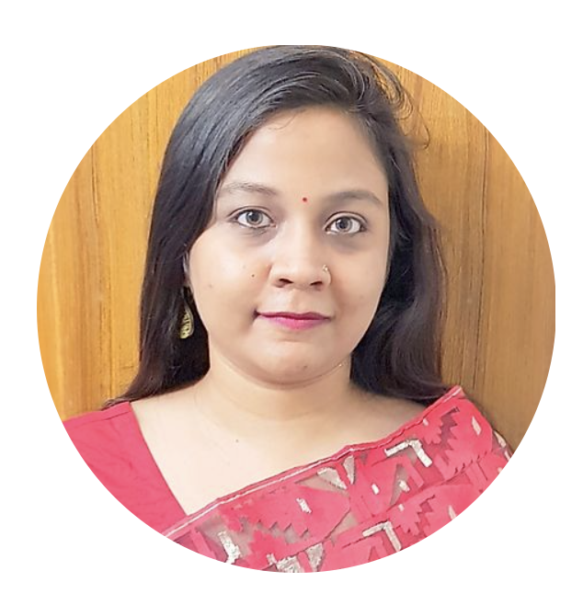
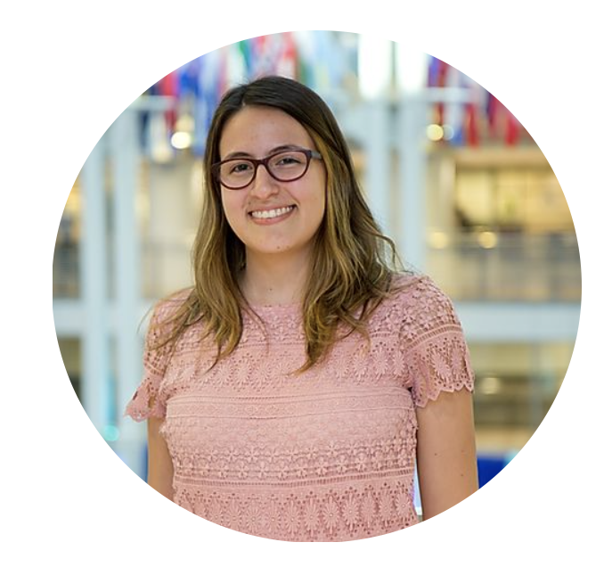
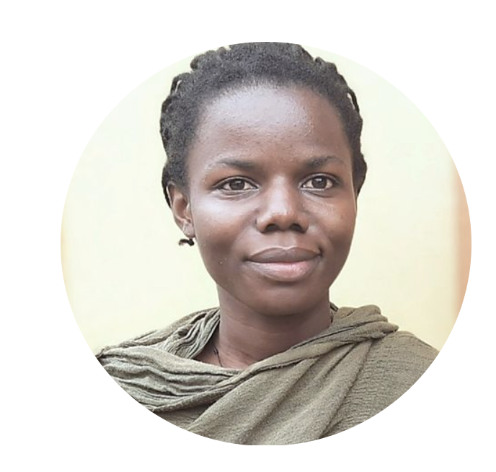
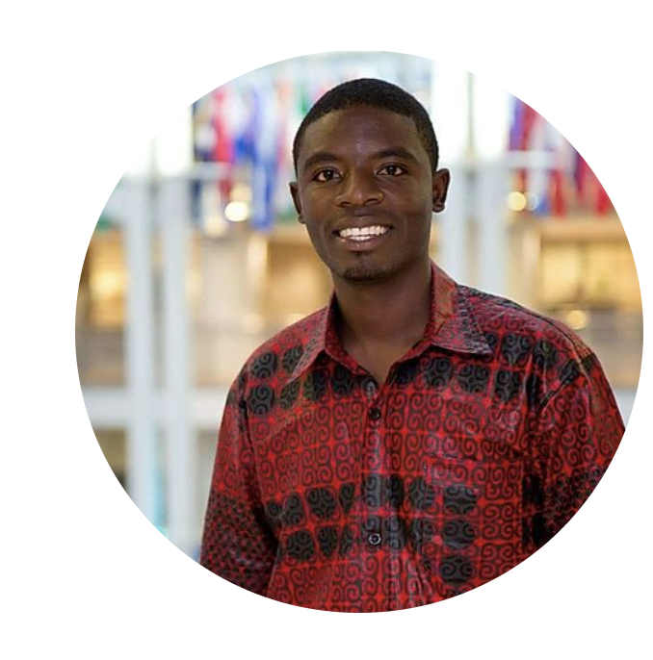
Regional Ambassadors: meet these leaders helping the Community Grow and Thrive
Managing Director
Communications Coordinator

Slide 30
Regional Ambassadors: meet these leaders helping the Community Grow and Thrive
Managing Director
Communications Coordinator

Slide 31
Listen to the voice of the future: Blogs, Articles, Books

Slide 32
Look around. Invest in each other. Be a good ancestor.
Defining our world by mapping it.

Slide 33
Every time you change the map you change minds about what a community of communities can do.

