Slide 1
Mapping health center facilities in Mugumu-Serengeti
Prepared By Herry kasunga

Slide 2
Health center facilities
In Mugumu –Serengeti Communities there is challenges of accessing health center facilities such as Hospitals, Clinics, Dispensaries and Pharmacies where there are only two Hospitals which offer different services for people who are in Mugumu town for people who live far from Mugumu-town Have to travel for Long Distances to get the services from those two hospitals if the treatment they require does not provided to their Village Clinics or Dispensaries. Different groups in the communities are affected Differently, from Elders, Pregnant women, Special Groups, Youths and Children.

Slide 3
Communities condition

Slide 4
Problems
Overpopulation of Patients at those two Hospitals which lead to patients to fail get the services on Time, Which may lead to More pain to a patient or even cause Death.
This cause many Pregnant Women To give Birth at Home or even on their Way to Hospitals or Clinics close to their villages.
Number of Death rate to Elders Increase due to lack of health services provided to them.
Women with pregnant fail to attend Clinics for check up due to Distance travel to reach Nearest clinics.
People in the Villages doesn’t know how to differentiate between services provided at Clinics, Dispensaries, Pharmacy and Hospitals .

Slide 5
Questions ???
Does Existing Health center provide Covid-19 vaccine?
Does Health center exist provide services for HIV People?
Does two Hospital available are capable of handling all people who are in need of services in Mugumu-Serengeti?

Slide 6
Addressing the problem
Using Open data tools to (collect data) map all health centers facilities available in 30 villages around Mugumu-Serengeti.
Involving partners who are interested on Health data such as Mara Red Cross team , Local Government and Community and Hope for Girls and Women Tanzania.
Engaging SETCO Youth Mappers to learn how they can Use Mapping knowledge to address and Solve Community challenges.

Slide 7
Example of Open tools Used

Slide 8
Challenges in Rural Area
The challenges you will find in many rural communities, where so many people don’t have access of computers, so you will have to start from scratch training people on using computers and smartphones, You can spend more time training community on using these tools.
Bridging the Gap of the rural communities have by empowering more Youth especially Girls and Women into Technology literacy

Slide 9
Technology literacy Gap in Rural communities

Slide 10
Methods:
Discussion with Community and Partners About Health center facilities available.
Create questionnaires for Collecting Health data in 30 Villages (ODK)
Using Healthsites.io updating health data and upload it to OSM.

Slide 11
Training sessions

Slide 12
Training partners
Training 25 new mappers on using tools such as Maps.me, OSMAnd, Kobo toolbox, ODK, ID editors and JOSM
For mapping , data collection and Data quality .
5 RED CROSS TEAM
10 SETCO YOUTH MAPPERS
5 COMMUNITY PEOPLE
5 HOPE FOR GIRLS AND WOMEN TANZANIA
75% PARTICIPANTS ARE GIRLS AND WOMEN

Slide 13
GOALS
Increasing the number of OSM community user AND contributors who can use OSM knowledge to solve Community Challenges
Health Data that will help on planning for health sites, by involving Rural planner officer and Government
Informative map that will be printed and given to all 30 villages Offices showing location of Health centers available in our community.
Accuracy of Data with local knowledge ,will be shared with OSM community.
To be a reliable providing Health Data in Mugumu-Serengeti
SDG #3 “Ensure healthy lives and promote well-being for all at all ages”

Slide 14
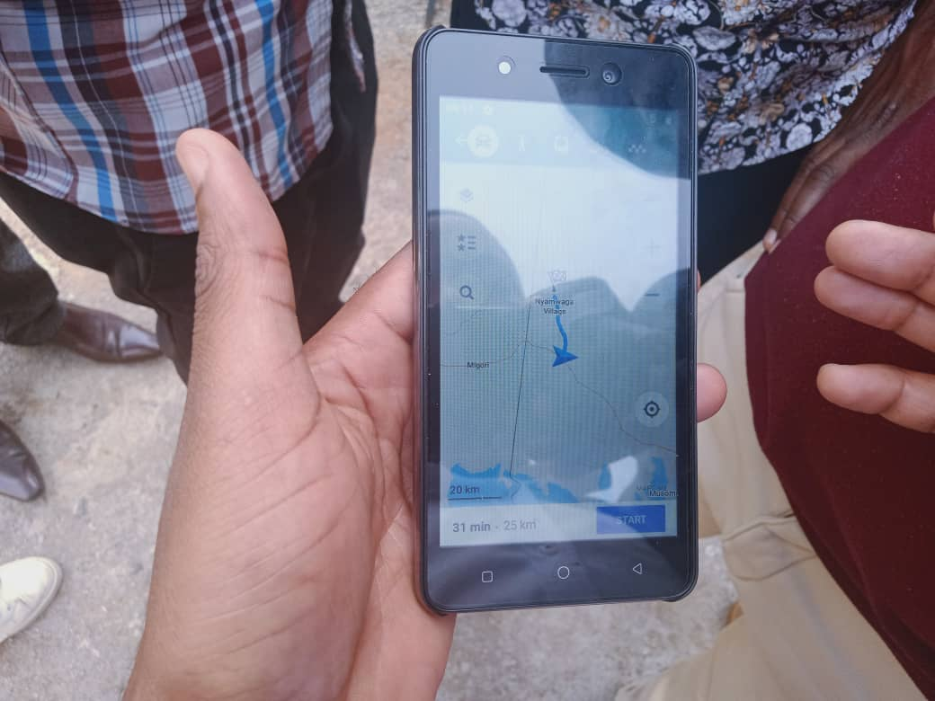
Adding local knowledge by using Smartphone apps

Slide 15
Sample of Collected data

Slide 16
Special thanks
Humanitarian OpenStreetMap Team for launching Microgrants to support OSM communities
OMDTZ for supporting us running this project with community Microgrant Project that help us Bought equipment such as Computers, smartphones and other material for the project
Local Government (Serengeti District Office )
Serengeti tourism College Principal
Health services provider and School teachers for helping us during data collection

Slide 17
For support
The project is still on –going for support you can map project on Tasking manager https://tasks.hotosm.org/projects/11609
We are working 30 villages in Mugumu –Serengeti out of 87 we would like to work on all the villages when we get a fund to proceed with all remaining villages would be great.
When other OSM communities and other partners would like to collaborate we are open and would like to share knowledge with them.
Devices for Data collection such as Smartphones and Computers

Slide 18
Contacts
Herry kasunga
Community Lead Project
Phone number +255676566460
Email herrykasunga88@gmail.com
Twitter @EldeSouza9
Website : https://hopeforgirlsandwomen.com/
And https://crowd2map.org/about-us/

