Slide 1
Mapping Nutrition Interventions and the Most Vulnerable Households in Bukoba Municipal, Kagera Region,
TANZANIA.

Slide 2
Introduction
Agri Thamani Foundation is National Registered NGO in Tanzania which uses innovative and sustainable approaches to add value interventions to fight against malnutrition in Tanzania
Agri Thamani’s became part of OSM community and won a micro grant from HOTOSM through Open Map Development Tanzania (OMDTZ) under the project known as; “Mapping Nutrition Interventions and the Most Vulnerable Households in Bukoba Municipal”
The project is mapping and collecting different data from vulnerable households, secondary schools, health centers and community gardens in streets and secondary schools using ODK, monitor field officers using Kobo tool box, uploading the generated data using JOSM, and lastly, using spatial data (QGIS) to develop evidence-based advocacy to multi-stakeholders

Slide 3
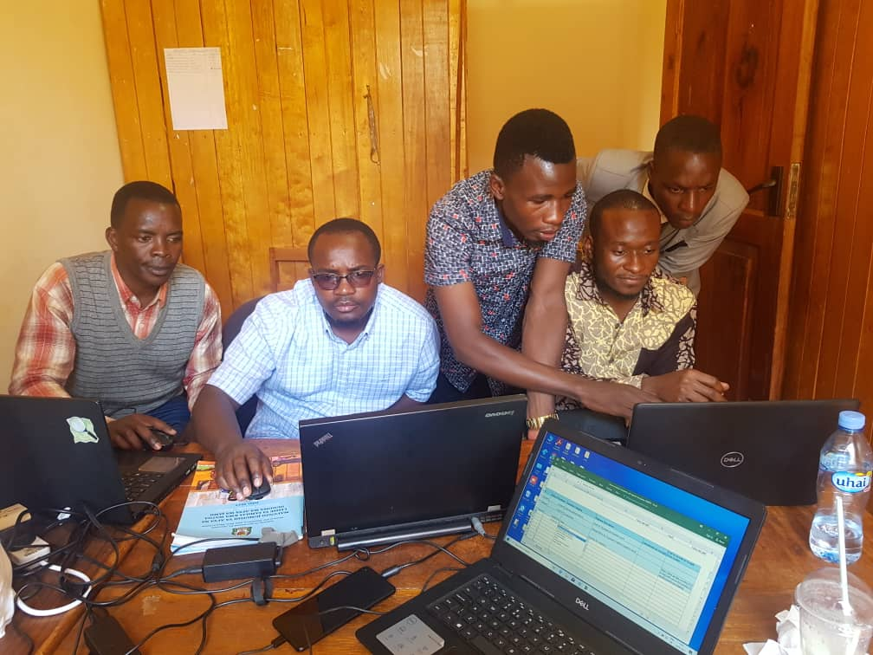
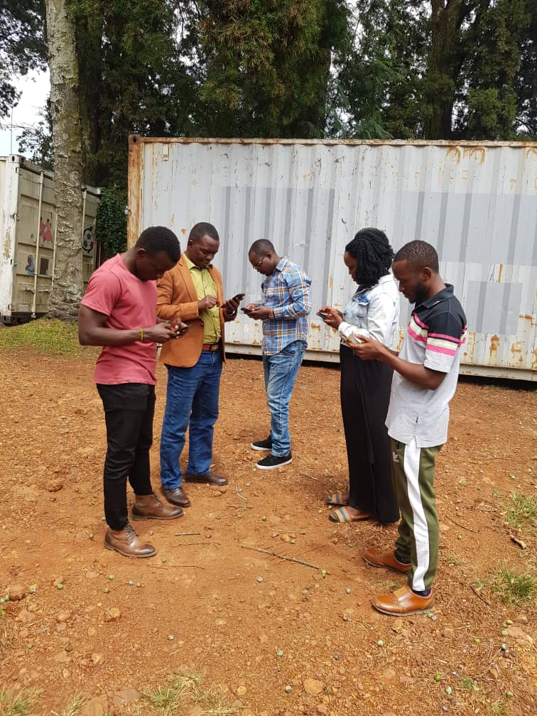
Achievements
Agri Thamani have been provided with an appropriate great level of support from OMDTZ in the implementation of this project through online and physical trainings on how to collect data, uploading data to OSM, creating to create project in hot tasking manager and time to time calling to support the project in case of any challenge

Slide 4
Achievements
As an organization we have gained many learnings over this first half of the grant period, this is our first project to conduct in the community where we learn on how to use OpenStreetMap to map areas of our interventions
We are now able to use Maps.me tool for mapping, ODK for data collection and to serve our data
This project provides a great impact to the community outreach and expands OSM communities and data Sharing as vulnerable households are added to Open Street Map and can be reached through map
It also helps to use spatial data to add value to our organization's advocacy activities to decision makers, stakeholders, and community members
The data that’s been collected during the project helps Local Government Authorities working to end malnutrition in Bukoba Municipal Council because we have involved government leaders( Ward and Sub-Ward Executive Officers) in identifying areas with vulnerable households for nutrition interventions.

Slide 5
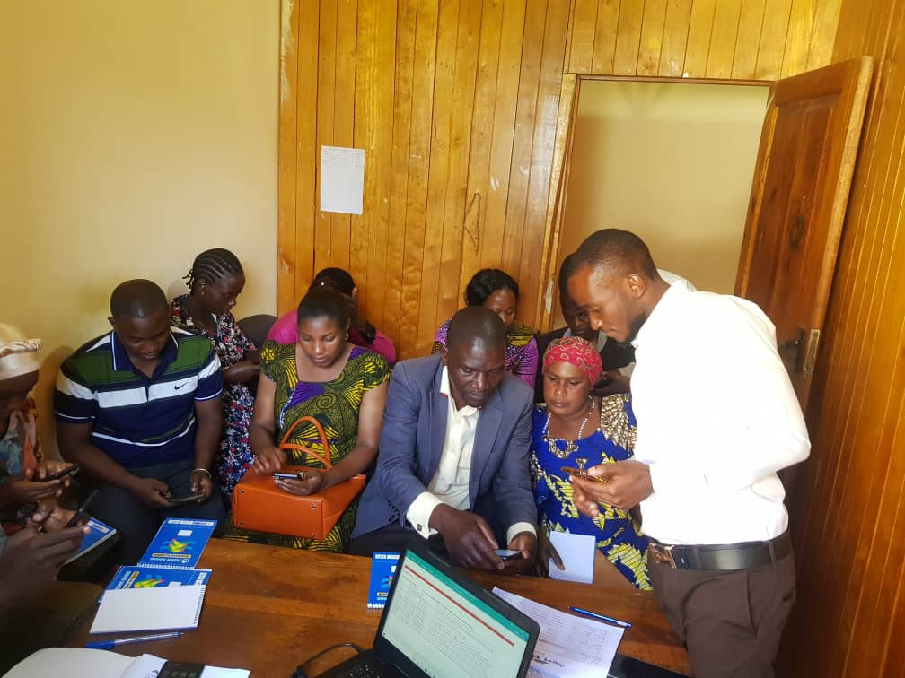
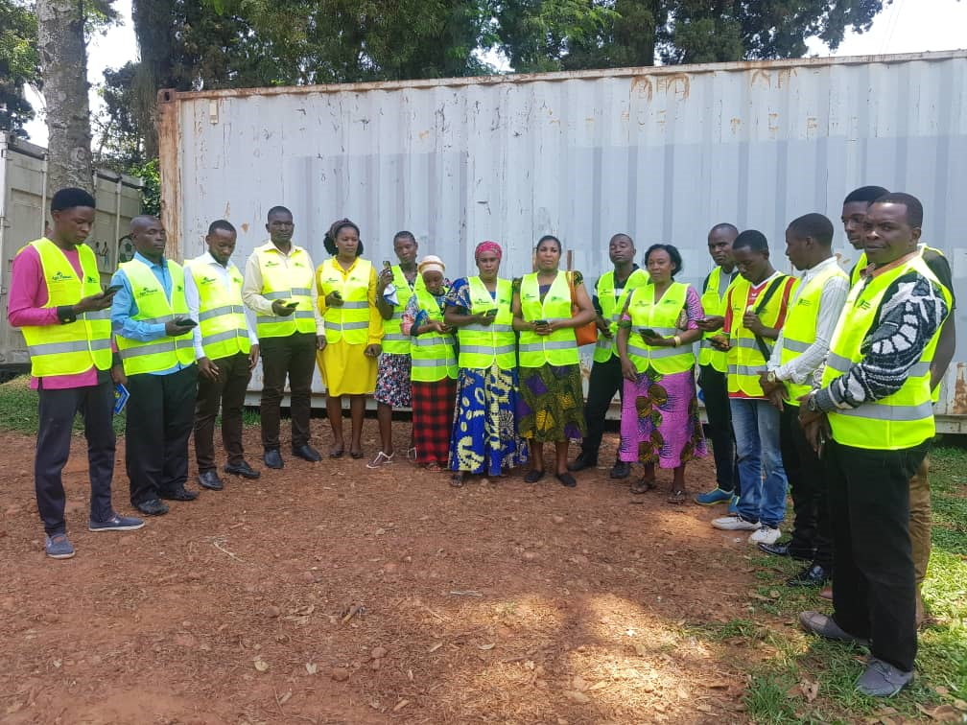
Mappers Training
Agri Thamani recruited and trained 14 Community Health Workers as field mappers/data collectors on ODK, who mapped Nutrition Interventions to elders Vulnerable Households and community gardens in every street in Bukoba Municipality.

Slide 6
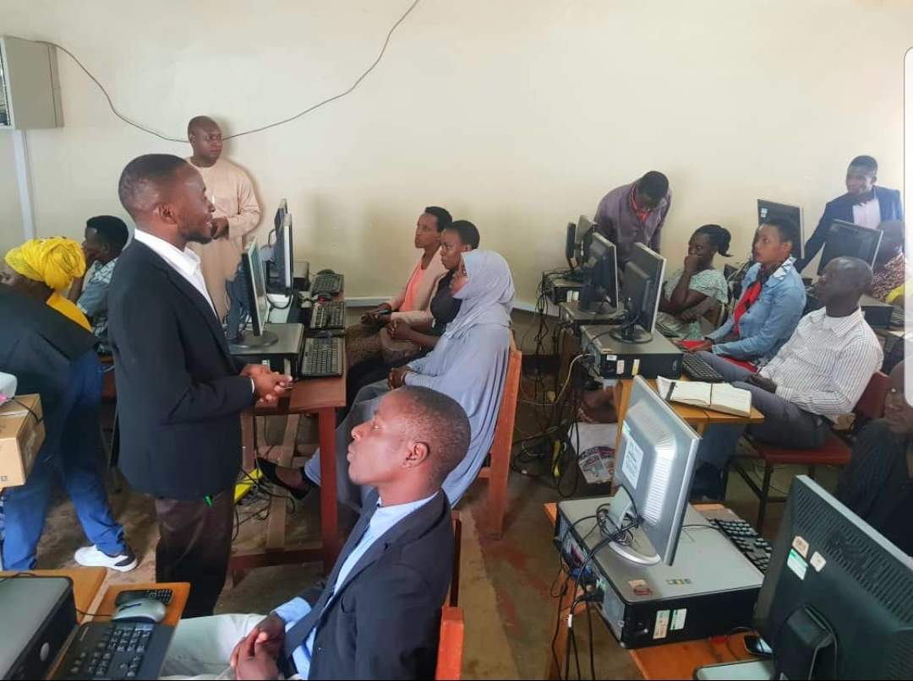
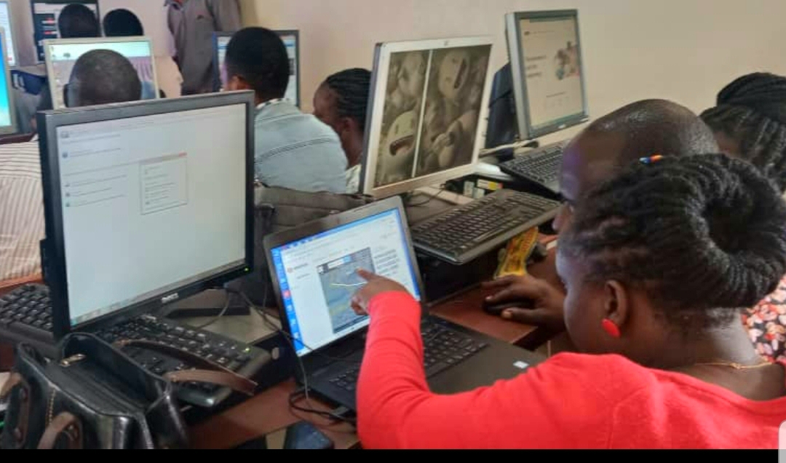
Mapathon Training
Agri Thamani trained and capacitated Local government leaders as new mappers to spread the knowledge about OSM with the community so that can add value to all efforts to end malnutrition and all its forms by using OSM related tools and data

Slide 7
Challenges during implementation of the project
The following are challenges occurred during the project implementation
All mappers/data collectors and our partners we trained in the areas of our interventions were their first time to engage in this project and they were no familiar in mapping
Almost of our mappers/data collectors do not know how to use phone based devices for data collection which lead us to conduct many trainings and follow-up
Many mappers are not familiar in using computers to add data in OSM which lead much time usage in adding data to the OSM through Mapathon activities

Slide 8
Opportunities
The following are the opportunities together
Kagera being a peripheral region there is huge potential for digitalization and use of open map data etc.
There is a huge potential for using data mapped as an advocacy tool to inform decision making
It is important to conduct digital literacy and digital skills training to communities in Kagera
Action taken following above opportunities
As a long term solution, Hon. Neema Lugangira (MP), Founder of Agri Thamani Foundation started the Omuka Hub that aims to bridge the rural digital gaps
Omuka Hub Office is situated in Bukoba, Kagera and has a team of 4 and will be launched in November 2021

