Slide 1
Leveraging AI for Road Mapping in Tanzania
Blog Post

Slide 2
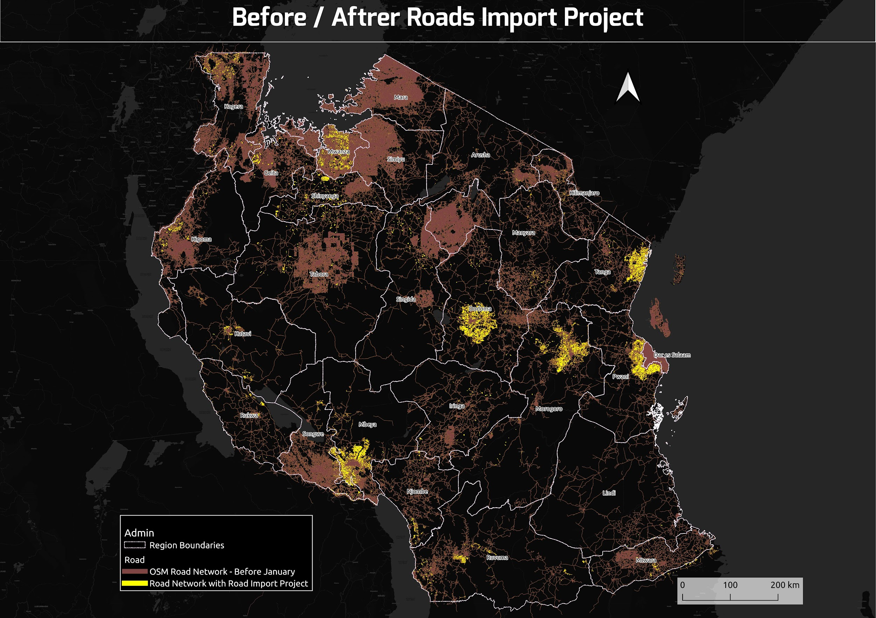

Slide 3
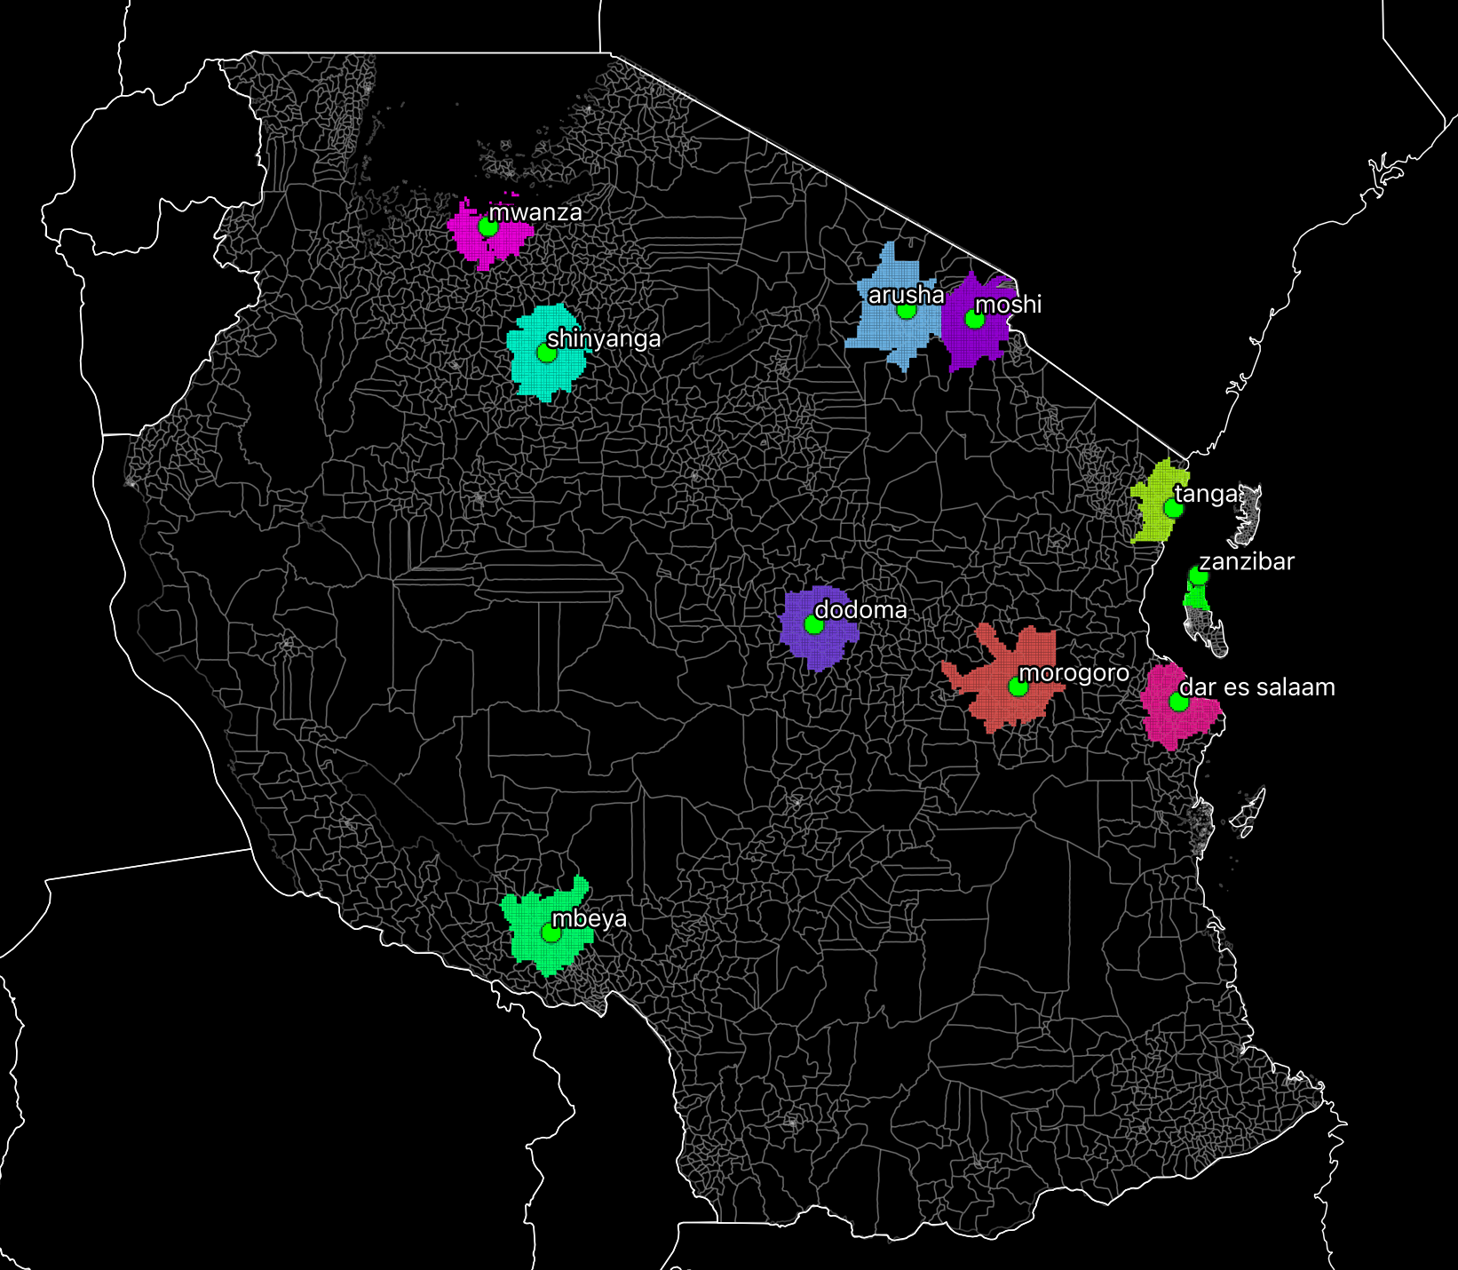
Reasons for Mapping Roads
Connecting people
Location
Bridging the gap
Humanitarian purpose
Criteria for Selecting towns in Tanzania
Population
Per Capita Income
Existing roads on OSM
Notes:
We do road mapping due to the following issues;
-It provides access to settlements.
-It provides access to social services like hospitals,schools, employment.
-It Facilitates economic growth and development.

Slide 4
Road Import- Mapping Methodology
Tasking Manager
Mapping guideline
JOSM
Ground truthing
1. TASKING MANAGER (NSOSMTM) (https://tm.nsosm.com/​)
Is the tool for coordination of volunteers and organization of groups to map on OpenStreetMap.
The purpose of the tool is to divide up a mapping job into smaller tasks that can be completed rapidly.

Slide 5
2.Mapping Guideline
Tanzania Mapping Guideline

Slide 6
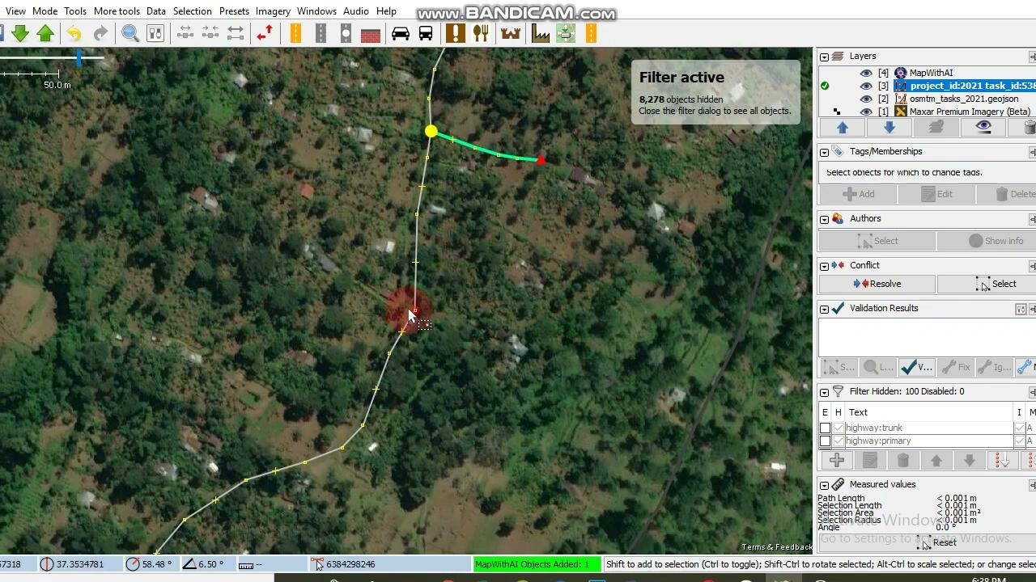
3.JOSM(MapwithAI)

Slide 7
4.Ground Truthing
Ground verification
Roads/Street Names together with Bridges and culverts points mapping, 11 Dodoma Urban wards were Mapped, 482 road segments were mapped with 301 bridges and culverts points
Mapillary Mapping. A total of 10,814 photo were uploaded to Mapillary
Public transport stops mapping, 255 stops were collected
Developed relationships with Institute of Rural Development Planning (IRDP) youth mappers and the Tanzania Rural and Urban Roads Authority (TARURA
Gained new skills from community member, TARURA and IRDP youth mappers

